Slide 1
Illustrations of the
Male Reproductive System

Slide 2
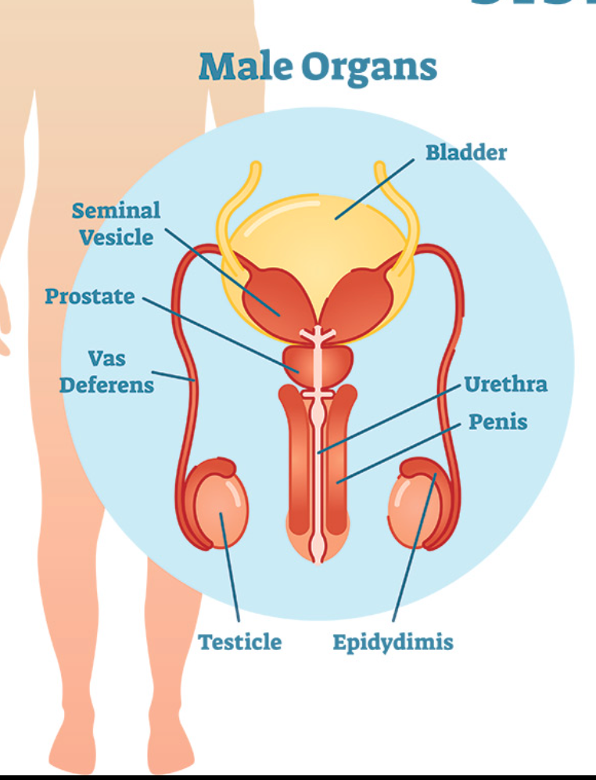
https://www.niehs.nih.gov/health/topics/conditions/repro-health/index.cfm
Notes:
[Point to each organ as you read its definition and purpose.]
The scrotum (sometimes called the scrotal sac) contains the testicles and epididymis and hangs under the penis
Next to each testicle the epididymis is a lightly coiled tube where the sperm are stored. From here, sperm are transported to the vas deferens.
Vas Deferens: Also called the ductus deferens, this think muscular tube transports sperm from the epididymis to the urethra.
Seminal Vesicles: Located at the base of the bladder, the two seminal vesicles secrete a thick fluid that nourishes the sperm.
The bladder is the muscular sac that sores the urine until it is released through the urethra.
Prostate Gland: This walnut-sized gland surrounds a portion of the urethra and produces some of the fluids in semen.
Penis is made of two parts: the shaft (the main part) and the glans (the tip sometimes called the head). The penis delivers sperm through the urethra into the female reproductive tract.
Urethra: The urethra is the tube that carries semen and urine out of the penis.

