Slide 1

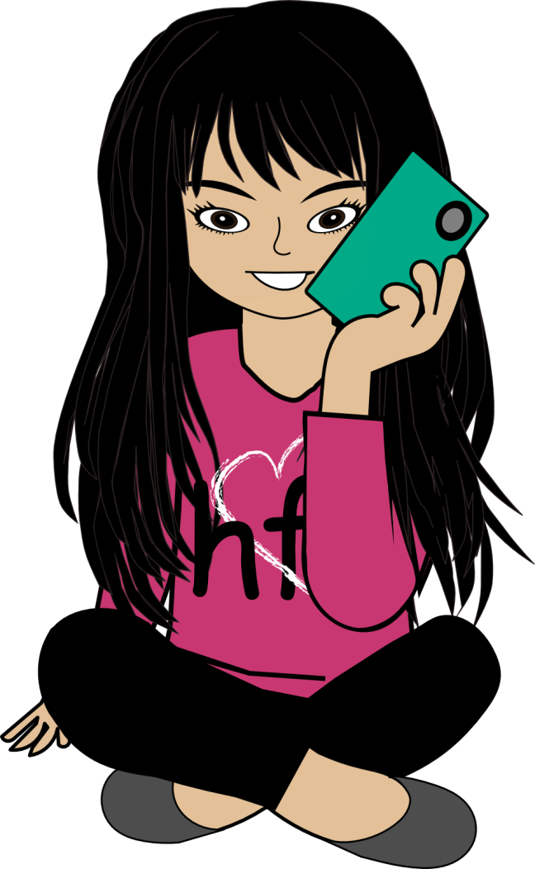
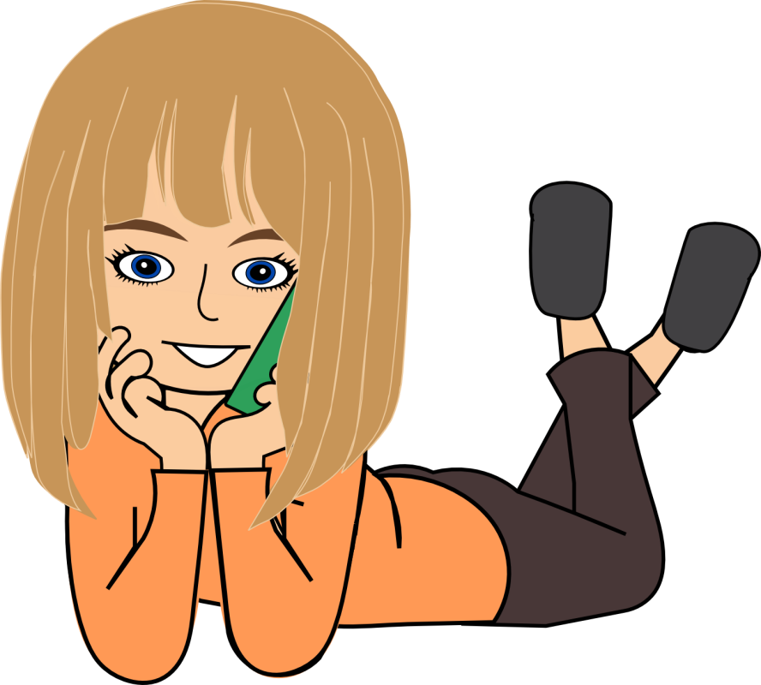
12:26PM
HF APP Store
Puberty Review
Think Fast!

Slide 2
12:26PM
1. is the process
of changing from a
child to an adult.
A. Puberty
B. Reproduce

Slide 3

12:26PM
Awesome Job!
Next question?
No
Yes

Slide 4
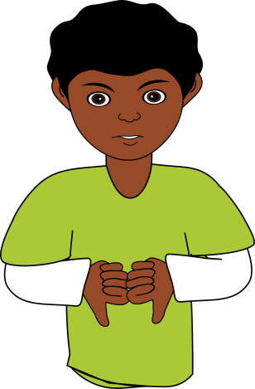
12:26PM
Incorrect!
Try Again?
Yes
No

Slide 5
12:26PM
2. Everyone goes through
puberty at the same time.
A. True
B. False

Slide 6
12:26PM
Awesome Job!
Next question?
No
Yes

Slide 7
12:26PM
Incorrect!
Try Again?
Yes
No

Slide 8
12:26PM
3. The tube in which the
egg travels from the
ovary to the uterus.
A. Vas Deferens
B. Fallopian Tube

Slide 9
12:26PM
Awesome Job!
Next question?
No
Yes

Slide 10
12:26PM
Incorrect!
Try Again?
Yes
No

Slide 11
12:26PM
4. A sudden increase in
height during puberty.
A. Growth
B. Clumsiness

Slide 12
12:26PM
Awesome Job!
Next question?
No
Yes

Slide 13
12:26PM
Incorrect!
Try Again?
Yes
No

Slide 14
12:26PM
5. Organs that store and
release the eggs and
produce hormones
in females.
A. Ovaries
B. Testicles

Slide 15
12:26PM
Awesome Job!
Next question?
No
Yes

Slide 16
12:26PM
Incorrect!
Try Again?
Yes
No

Slide 17
12:26PM
6. Clogged pores sometimes
experienced during puberty.
A. Pimples
B. Hair Growth

Slide 18
12:26PM
Awesome Job!
Next question?
No
Yes

Slide 19
12:26PM
Incorrect!
Try Again?
Yes
No

Slide 20
12:26PM
7. The release of an egg
from a woman’s ovary.
A. Ovulation
B. Bladder

Slide 21
12:26PM
Awesome Job!
Next question?
No
Yes

Slide 22
12:26PM
Incorrect!
Try Again?
Yes
No

Slide 23
12:26PM
8. Testicles/testes are where
sperm and testosterone are
produced in males.
A. True
B. False

Slide 24
12:26PM
Awesome Job!
Next question?
No
Yes

Slide 25
12:26PM
Incorrect!
Try Again?
Yes
No

Slide 26
12:26PM
9. The female internal organ
where the baby develops
before birth.
A. Urethra
B. Uterus

Slide 27
12:26PM
Awesome Job!
Next question?
No
Yes

Slide 28
12:26PM
Incorrect!
Try Again?
Yes
No

Slide 29
12:26PM
One of the changes in
puberty that causes you
to smell when you sweat.
A. Body odor
B. Pimples

Slide 30
12:26PM
Awesome Job!
Next question?
No
Yes

Slide 31
12:26PM
Incorrect!
Try Again?
Yes
No

Slide 32
12:26PM
11. Breast growth only happens
to girls during puberty.
A. True
B. False

Slide 33
12:26PM
Awesome Job!
Next question?
No
Yes

Slide 34
12:26PM
Incorrect!
Try Again?
Yes
No

Slide 35
12:26PM
12. Final Question:
Only boys have a bladder.
A. True
B. False

Slide 36
12:26PM
Awesome Job!
Next question?
No

Slide 37
12:26PM
Incorrect!
Try Again?
Yes
No

