Slide 1
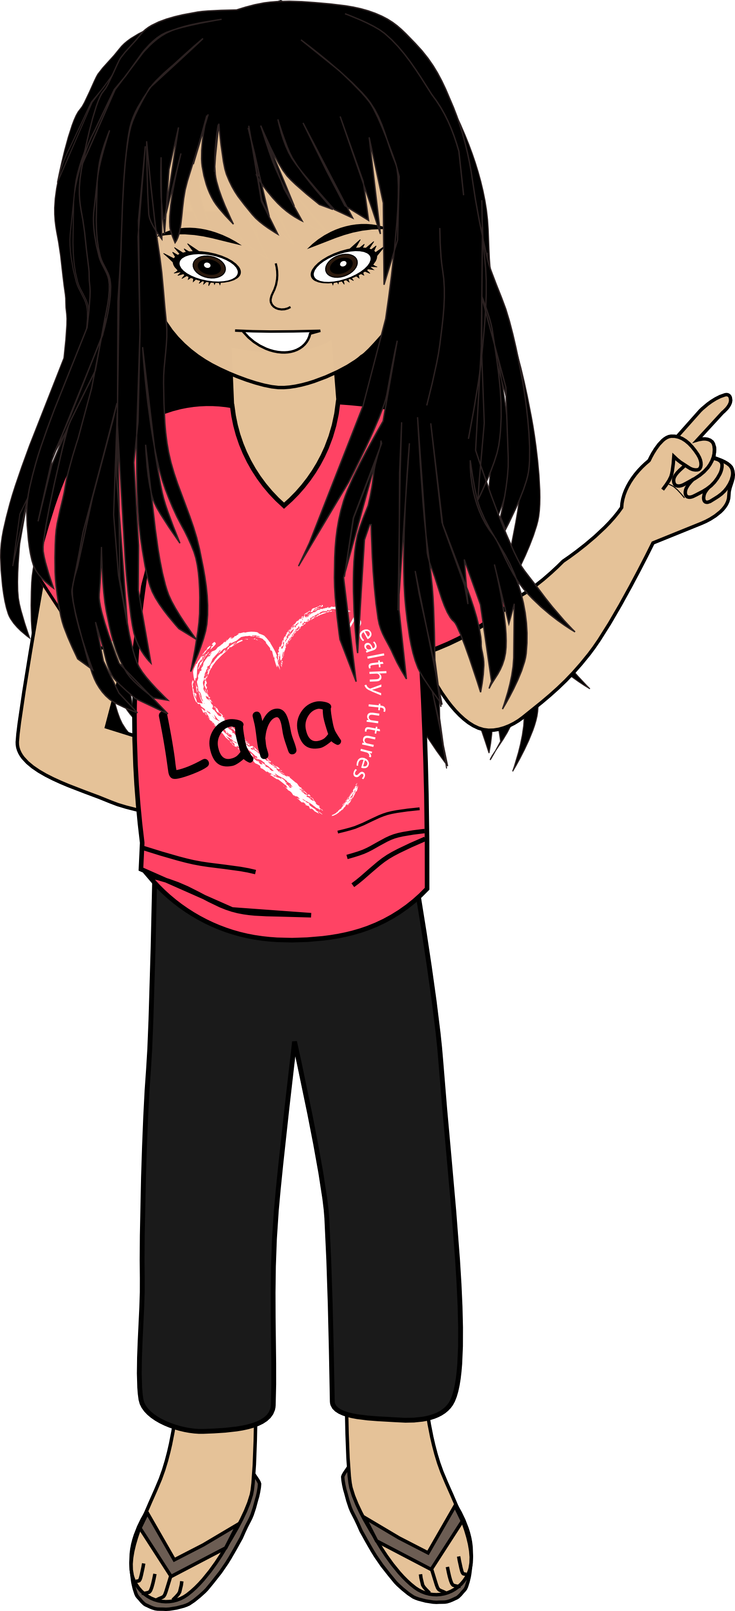


HEALTHY FUTURES
!
Refusal
Skills
It’s okay to
say NO

Slide 2
Refusal Skills – It’s okay to say NO!
Here are some ideas
for handling
high pressure SITUATIONS

Slide 3
Call it what it is and say…
“NO” or “NO, thanks”.
“NO. That's cheating (stealing, bullying, using drugs, not following the rules, etc.)”.
“NO, thanks. I don’t drink.”

Slide 4
You can use humor…
HAHAHA
LOL
“You have to be kidding; I care about my lungs.”
(smoking)
HAHAHA
LOL

Slide 5
Give reasons why you shouldn’t do it…
"I could get hurt.“
“I might feel bad later.”
“My parents might find out.”

Slide 6
Think of something else to do…
(this will distract you from the temptation)
"I think I’ll go ride my bike.”
“I’m going to leave this store”
(shoplifting)
If you want their friendship, keep the door open by saying something like, “If you decide to do something else, let me know.”

Slide 7
!
Give yourself credit for staying in...
control
and
making good
choices

