Slide 1


Puberty & Pregnancy Review

Slide 2
When thinking about PUBERTY, many teens ask themselves…
When will I start to change?
Am I normal?!
Why do I look different?
Why do I feel this way?
Notes:
Am I normal?
Why do I look different?
When will I start to change?
Why do I feel this way?
Is my body normal?
How tall will I be?
When will I be able to date?
Is it ok to have sexual thoughts or feelings?

Slide 3
The most important thing to remember about puberty is…
It happens differently
for everyone!!!
Notes:
The comforting news is that everyone goes through puberty. However, everyone also experiences puberty in different ways. The questions on the slide are normal questions a lot of teens have during puberty. Everyone’s body has its own timetable. Some of you are well into puberty and some of you have not started puberty yet. Both are normal. As a result of the body growing and maturing, teens begin to think more about sex or have sexual feelings. That too is normal. As you begin to think more about sex or have sexual feelings, it is important you talk with your parents/guardians. Remember, if you have these concerns right now, that is normal. If you don’t have these concerns yet, that is also normal.

Slide 4
Boys 10-18
Girls: 9-17
Physical Changes
Emotional Changes
Ability to reproduce
Puberty is the process
of changing from
a child into an adult
Notes:
Before we go any further, let’s go ahead and define what puberty is. Puberty is the process of changing from a child into an adult. As we already mentioned, this is a process everyone experiences in their own unique ways. Each person begins and ends puberty at different times. However, typically, girls begin and end puberty earlier than boys. The average ages for puberty to occur in girls is 9-17, whereas boys average ages are 10-18. Puberty affects every aspect of who you are. The most obvious change that occurs with puberty is that your body begins to change, and gains the ability to reproduce (or have children). Your emotions and interests will change during this time period as well.

Slide 5
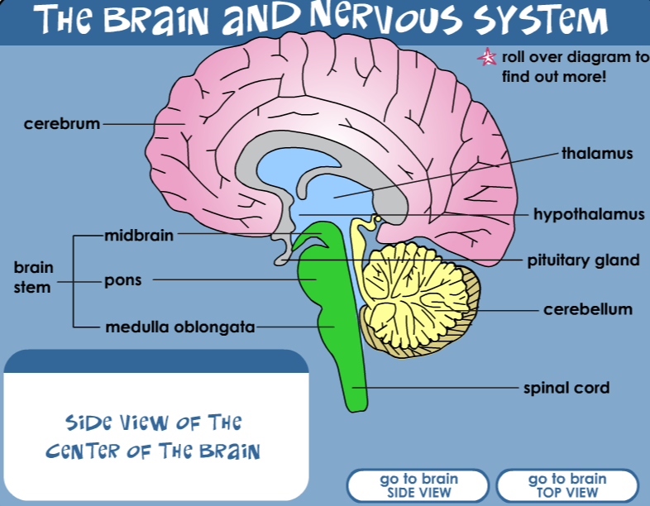
The Pituitary Gland
At the base of the brain
is the pituitary gland
which is about the size
of a pea.
The pituitary gland
sends signals to the rest
of the body that causes hormones to be released
and puberty to begin.
© The Nemours Foundation/KidsHealth. All rights reserved.
Notes:
So, you may be wondering what is responsible for these changes that are transforming you from a child to an adult? The main biological explanation is something called the pituitary gland. This gland, located at the base (or bottom) of your brain, is so tiny that it is about the size of a pea! However, it is very powerful. This gland is responsible for the hormone production in your body. It signals to the rest of your body the information it needs in order to release the appropriate hormones and signal the beginning of the puberty process. The hormones affect girls and boys differently.

Slide 6
Puberty in Girls
Armpit hair growth
Able to reproduce (egg cells release)
Period begins
Body odor
Breast bud appears
Oily skin/pimples
Breast growth
Pubic hair growth
Voice changes
Growth spurts
Hips widen
Aching muscles
Emotional changes
Clumsiness
Notes:
Puberty in Girls
Able to reproduce (egg cells release)
Period begins
Breast buds appear
Breast growth
Pubic hair growth
Armpit hair growth
Body odor
Oily skin/pimples
Voice changes
Growth spurts
Hips widen
Aching muscles
Emotional changes
Clumsiness

Slide 7
Puberty in Boys
Armpit hair growth
Able to reproduce (produce sperm)
Body odor
Testicles grow
Breast growth
Voice changes
Penis and scrotum grow
Growth spurt
First ejaculation
Pubic hair growth
Muscle growth
Shoulders broaden
Aching muscles
Facial hair growth
Oily skin/pimples
Emotional changes
Clumsiness
Notes:
Puberty in Boys
Able to reproduce (produce sperm)
Testicles grow
Penis and scrotum grow
First ejaculation
Pubic hair growth
Armpit hair growth
Body odor
Breast growth
Voice changes
Growth spurts
Muscle growth
Shoulders broaden
Aching muscles
Facial hair growth
Oily Skin/pimples
Emotional changes
Clumsiness
Now we are going to review the male and female anatomy.

Slide 8
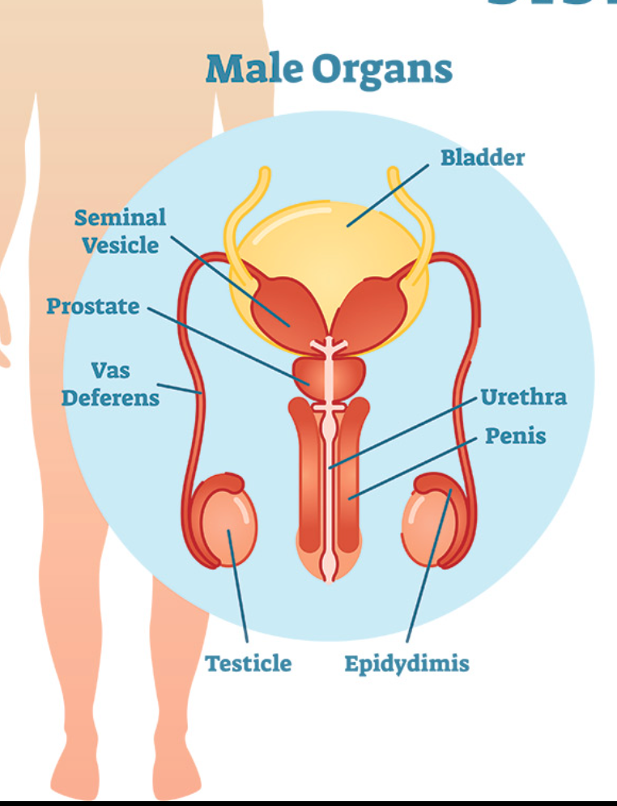
The Male Anatomy Review
Male Anatomy Terms
Testosterone
Erection
Ejaculation
Sperm
Semen
Notes:
The name of the primary sex hormone in males is testosterone. Testosterone leads to the changes in reproductive organs and give men many of their male characteristics. The testicles are located under the penis. This is where sperm, which are reproductive cells, are produced. The sperm is stored in the epididymis. The vas deferens carry the sperm from the epididymis to the prostate, where the sperm combines with semen. Semen, a white or gray fluid, is produced in the seminal vesicle. When sexually aroused, an erection will occur where the penis becomes firm and enlarged. During orgasm, ejaculation takes place and semen and sperm are released through the urethra.

Slide 9
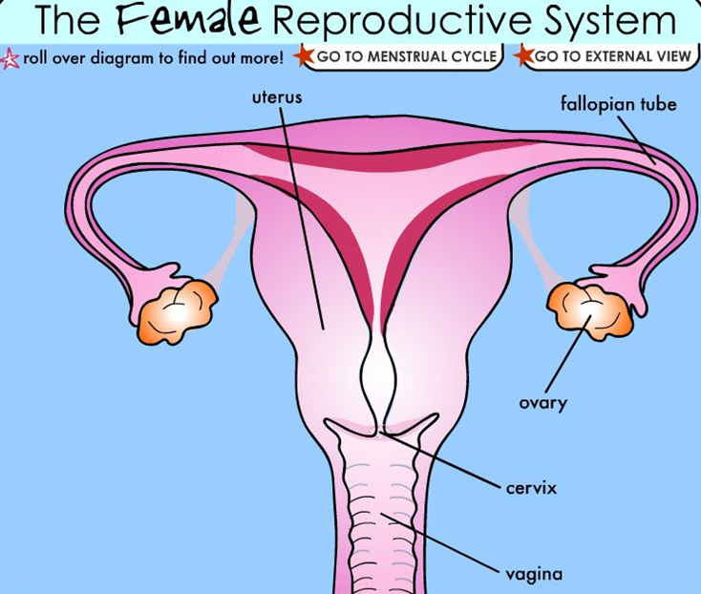
Female Anatomy Review
Female Anatomy Terms
Estrogen
Ovulation
Egg
Menstruation
© The Nemours Foundation/KidsHealth. All rights reserved.
Notes:
A female has two ovaries which store her egg cells until they are ready to be released. These organs also produce the female hormone estrogen, which give women many of their female characteristics. Females also have two fallopian tubes which extend from the uterus toward the ovaries. These tubes contain cilia which create a current that allow the eggs to travel to the uterus. The uterus is the organ where the fetus and embryo develop if a female becomes pregnant. The uterus contains a lining made up of blood and tissue that is shed every month along with any unfertilized egg during menstruation, also known as the monthly period. If a female is pregnant, she will not get her period. Below the uterus is the cervix with a small opening that connects the uterus to the vagina. The vagina connects the female internal reproductive organs with the outside of the body. The vagina is where sexual intercourse takes place, where the menstrual blood and tissue is released during a period, and is the canal through which a baby leaves the uterus during childbirth.

Slide 10
Let’s Review Pregnancy
© The Nemours Foundation/KidsHealth. All rights reserved.
Notes:
It is important to know the parts of the reproductive system and what each does in order to understand how a pregnancy occurs. About once a month, a female releases egg(s) from the ovaries and that egg travels down the fallopian tube toward the uterus. This process is called ovulation and is shown here. During sexual intercourse, the male ejaculates, releasing sperm from the penis into the female’s vagina. Sperm have tail-like structures enabling them to travel up through the cervix and uterus to the fallopian tubes and reach the egg(s). If an egg is present a sperm and egg will join and continue to travel to the uterus. This process is called fertilization. When the fertilized egg reaches the uterus, it will attach to the lining, where it will receive nourishment and develop into a baby. Nine months later, the female will give birth.

Slide 11
Normal Teen Concerns
How tall will I be?
Is my body normal?
Is it okay to have sexual thoughts or feelings?
When will I be able to date?
Notes:
Now that we have addressed the major changes that occur to you physically during puberty, let’s talk about how puberty might affect you emotionally.

Slide 12
Emotional Rollercoaster
During puberty everyone will begin to mature emotionally.
Some days you might wake up and feel happy and you’re smiling at everyone.
Not everything you liked when you were younger is going to be as cool now.
Other days you might be sad or mad at the world.
Notes:
Some days, hours, or even moments are going to feel like an emotional roller coaster. You might wake up feeling happy one day and other days you might be sad or mad at the world. These emotions are a normal part of puberty.

Slide 13
Getting through puberty…
Take care of your body!
Get enough sleep
Eat healthy
Exercise
Avoid risky behaviors!
Take care of your mind!
Expect ups and downs
Talk to others
Get involved in your school
Get involved in your community
Plan for the future
Notes:
All of these changes may seem overwhelming at times. We have talked about a lot of changes you are going to be experiencing over the next few years, so it is important for you to know how to cope with these changes. Since both your body and mind are affected by puberty, it is important to take care of them! For your body, remember that getting enough sleep, eating healthy, exercising, and avoiding risky behaviors will all help.
For your mind, expect the emotional ups and downs we just discussed. It helps to talk to friends and peers who can relate to these same feelings. If you feel like these feelings are really overwhelming, it is important to talk with a trusted adult. Remember when we talked about our keys to success, it’s important that you know who to talk to. You can also get involved in helping others in your school and your community to help take your mind off of these changes. Lastly, remember that some emotions are fleeting and that the choices you make now, affect your future, so plan and think before you act.

