Slide 1
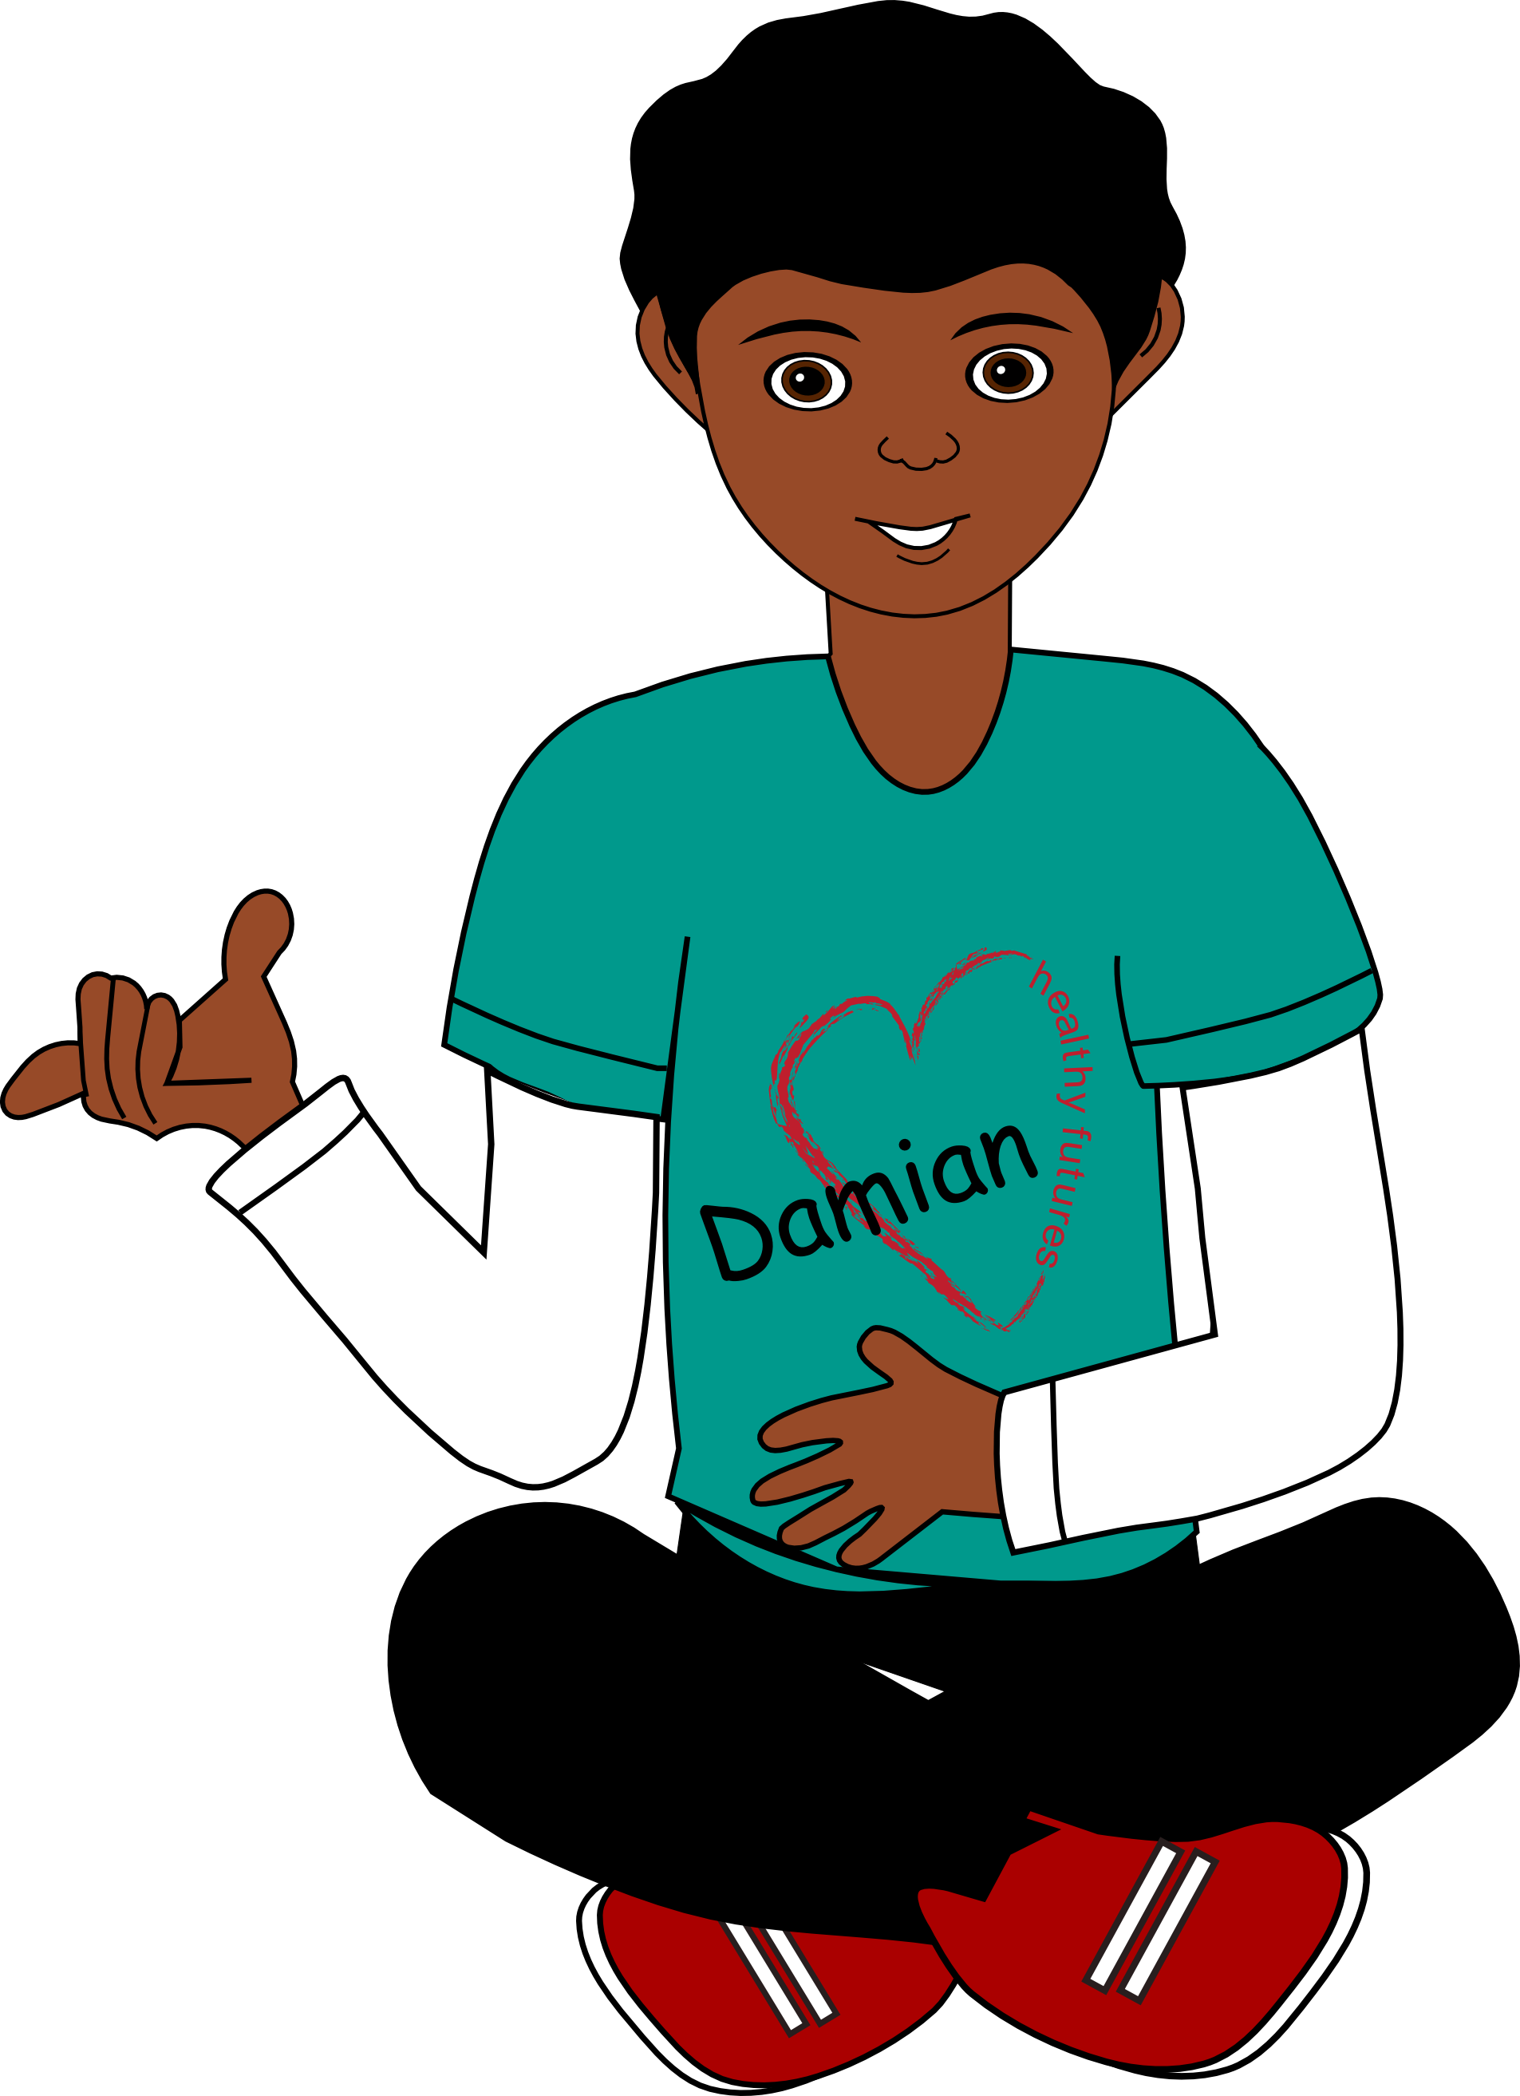

Nu-CULTURE
Emotional
Needs

Slide 2


Emotional Needs
Everybody
has them

Slide 3








Emotional Needs
Affirmation: Positive statement
from others
Belonging: Acceptance, approval from others
Recognition: Attention or favorable notice from others
Guidance: Advice from others, direction

Slide 4





Emotional Needs
Respect: Consideration from others; showing
consideration
to others
Safety:
Safe and secure from harm; feeling protected
Support:
Words & actions that let you know that others will help you & stand up for you
Unconditional
Love:
Love without judgment; both physical and emotional affection

Slide 5
Affirmation
Positive
statement from
others

Slide 6

Belonging
Acceptance, approval from others

Slide 7
Guidance
Advice from others, direction

Slide 8
Recognition
Attention or favorable notice from others

Slide 9
Respect
Consideration from others; showing consideration
to others

Slide 10
Safety
Safe and
secure from
harm; feeling
protected

Slide 11
Support
Words & actions
that let you know
that others will
help you &
stand up for you

Slide 12
Love
Love without judgment;
both physical
& emotional affection

Slide 13
Remember there are healthy
and unhealthy ways to
get your needs met
Make
sure you
CHOOSE
Healthy
ways to meet
your needs

