Slide 1


Think Fast!
To play slide show:
Select the “Slideshow” tab.
2. Click the “From Beginning” command.
3. Use right arrow key on your computer’s
keyboard for slides 1-4 ONLY.
4. On Slide 4 (Categories), have students pick a
category and number to reveal question slide.
5. For slides 5-64, use the following buttons:
Press red button for incorrect buzzer.
Press green button for
correct buzzer and advance to answer slide.
Press yellow button to return to Categories board.
*Please make sure your audio has been turned on.

Slide 2
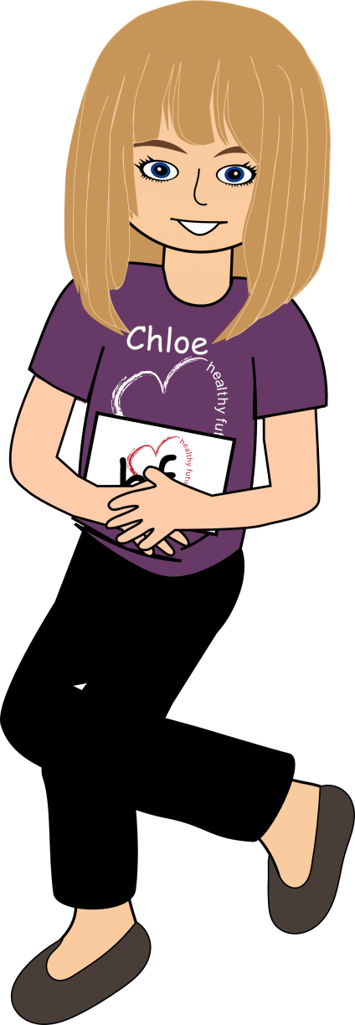
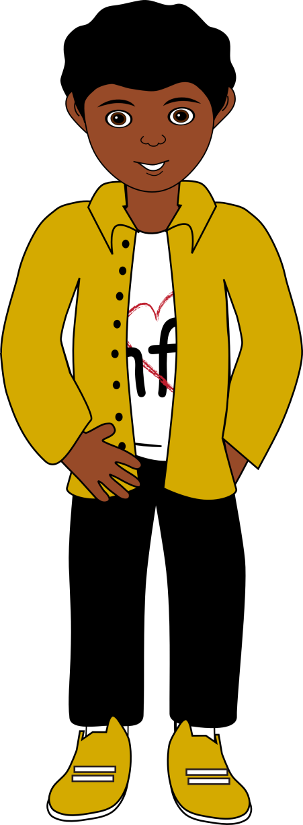
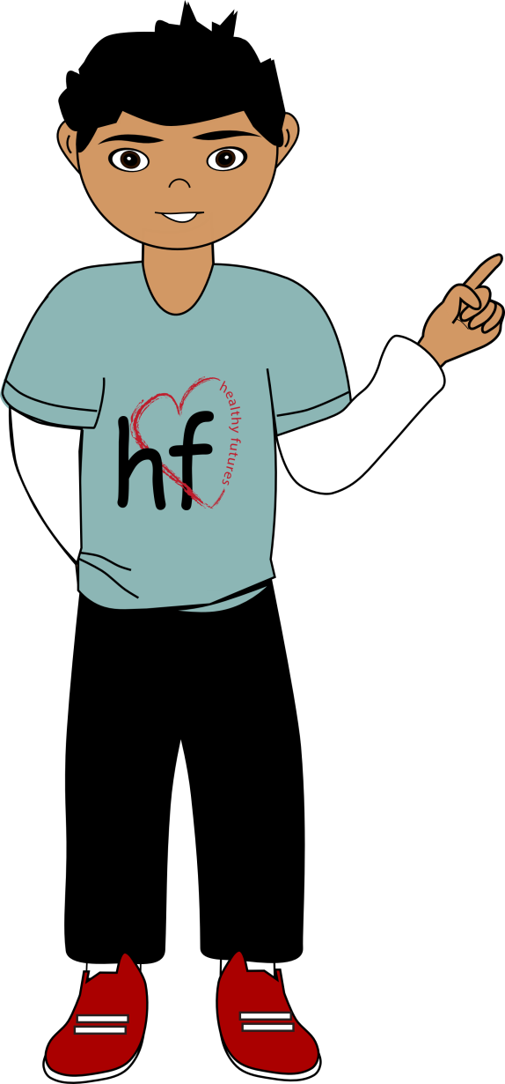
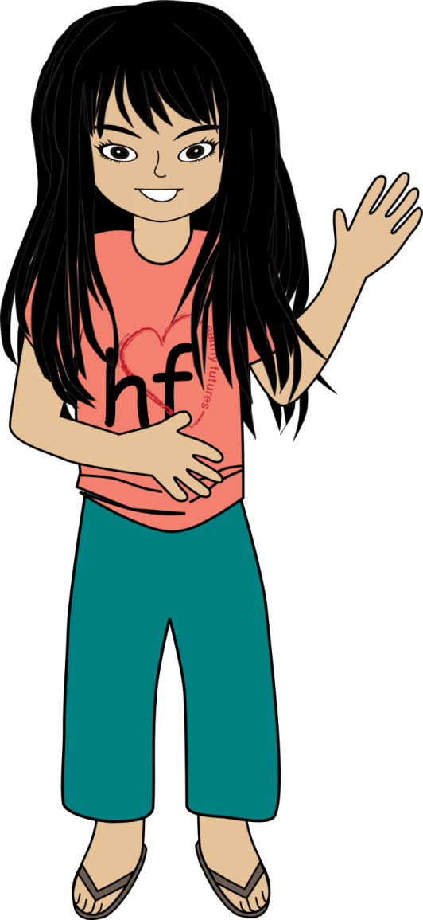

Think Fast!
2500
1000
500
Lana
Damian
Alex

Slide 3

Categories
*use right arrow key on keyboard to make the board appear
Friendship
Decision
Making
Puberty/
Anatomy
Healthy/
Unhealthy
Love
Abuse/
Conflicts
100
100
100
100
100
100
200
200
200
200
200
200
300
300
300
300
300
300
400
400
400
400
400
400
500
500
500
500
500
500

Slide 4



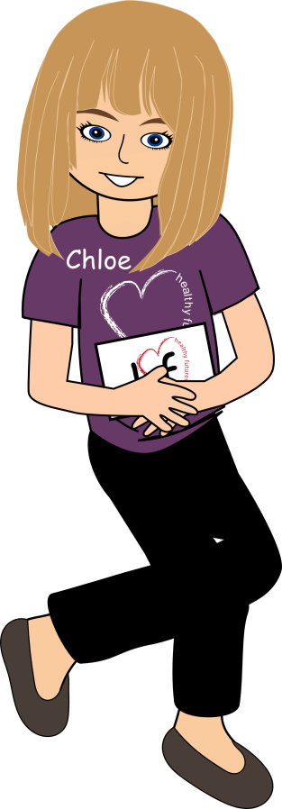
One friend is sad because
their team lost a game.
The other friend tries to cheer
his/her friend up by offering to go
out for ice cream.
2500
1000
500
Lana
Damian
Alex

Slide 5
A healthy friendship.
Friendship: 100
2500
1000
500
Lana
Damian
Alex

Slide 6


One friend is controlling
and yells at his friend.
2500
1000
500
Lana
Damian
Alex

Slide 7
An unhealthy friendship.
Friendship: 200
2500
1000
500
Lana
Damian
Alex

Slide 8
Name 2 reasons why
we want friends.
2500
1000
500
Lana
Damian
Alex

Slide 9
_________ and _________
Friendship: 300
2500
1000
500
Lana
Damian
Alex

Slide 10
Name 3 problems
that can make
friendship hard.
2500
1000
500
Lana
Damian
Alex

Slide 11
________, ________and _________
Friendship: 400
2500
1000
500
Lana
Damian
Alex

Slide 12
Name 5 of 10 qualities
of a good friend.
2500
1000
500
Lana
Damian
Alex

Slide 13
1. Respectful
2. Fun
3. Kind
4. Loyal
5. Helpful
6. Trustworthy
7. Honest
8. Responsible
9. Good listener
10. Good role-model
Friendship: 500
2500
1000
500
Lana
Damian
Alex

Slide 14
______ means to choose
not to do something.
2500
1000
500
Lana
Damian
Alex

Slide 15
Abstain means to choose
not to do something.
Decision Making: 100
2500
1000
500
Lana
Damian
Alex

Slide 16
The choices you
make _______will affect
you__________!
2500
1000
500
Lana
Damian
Alex

Slide 17
The choices you
make now will affect
you later!
Decision Making: 200
2500
1000
500
Lana
Damian
Alex

Slide 18
Stop, Think and Decide
2500
1000
500
Lana
Damian
Alex

Slide 19
The 3 step process for
making good decisions.
Decision Making: 300
2500
1000
500
Lana
Damian
Alex

Slide 20
______means to choose to
wait and not be involved
in any sexual activity
until you are in a faithful
lifelong relationship.
2500
1000
500
Lana
Damian
Alex

Slide 21
Abstinence means to choose to
wait and not be involved
in any sexual activity
until you are in a faithful
lifelong relationship.
Decision Making: 400
2500
1000
500
Lana
Damian
Alex

Slide 22
Name 3 risks and
dangers of sexual
activity before a faithful,
lifelong relationship.
2500
1000
500
Lana
Damian
Alex

Slide 23
Pregnancy/father a child,
STDs and emotional heartache.
Decision Making: 500
2500
1000
500
Lana
Damian
Alex

Slide 24
_______ is the process
of changing from a
child to an adult.
2500
1000
500
Lana
Damian
Alex

Slide 25
Puberty is the process
of changing from a
child to an adult.
Puberty/Anatomy: 100
2500
1000
500
Lana
Damian
Alex

Slide 26
These produce sperm
and testosterone and are
located inside the scrotum.
2500
1000
500
Lana
Damian
Alex

Slide 27
Testes
Puberty/Anatomy: 200
2500
1000
500
Lana
Damian
Alex

Slide 28
These are located
in the female
reproductive system
and contains eggs.
2500
1000
500
Lana
Damian
Alex

Slide 29
Ovaries
Puberty/Anatomy: 300
2500
1000
500
Lana
Damian
Alex

Slide 30
This is a stretchy muscle
where the baby will
grow and stay for
about 9 months.
2500
1000
500
Lana
Damian
Alex

Slide 31
Uterus
Puberty/Anatomy: 400
2500
1000
500
Lana
Damian
Alex

Slide 32
Name 4 of the changes
that happen to both
boys and girls.
2500
1000
500
Lana
Damian
Alex

Slide 33
1.Growth
2. Clumsiness
3. Oily skin/pimples
4. Aching muscles
5. Emotional changes
6. Hair growth
7. Ability to Reproduce
8. Breast growth
9. Voice changes
10. Body odor
Puberty/Anatomy: 500
2500
1000
500
Lana
Damian
Alex

Slide 34
______ means unsuitable,
improper – anything that
makes the other person feel
uncomfortable or unwanted.
2500
1000
500
Lana
Damian
Alex

Slide 35
Inappropriate means unsuitable,
improper – anything that
makes the other person feel
uncomfortable or unwanted.
Healthy/Unhealthy: 100
2500
1000
500
Lana
Damian
Alex

Slide 36
______ is the ability to set
limits and keep to them. It’s
letting others know you
mean what you say.
2500
1000
500
Lana
Damian
Alex

Slide 37
Assertiveness is the ability to
set limits and keep to them.
It’s letting others know you
mean what you say.
Healthy/Unhealthy: 200
2500
1000
500
Lana
Damian
Alex

Slide 38
The most appropriate
way to show affection
without being physical.
2500
1000
500
Lana
Damian
Alex

Slide 39
Being a good friend.
Healthy/Unhealthy: 300
2500
1000
500
Lana
Damian
Alex

Slide 40
Name 3 ways to
show respect and
responsibility
to parents/adults.
2500
1000
500
Lana
Damian
Alex

Slide 41
________, ________ and_________
Healthy/Unhealthy: 400
2500
1000
500
Lana
Damian
Alex

Slide 42
Name 4
emotional needs.
2500
1000
500
Lana
Damian
Alex

Slide 43
1. Affirmation
2. Belonging
3. Guidance
4. Recognition
5. Respect
6. Safety
7. Support
8. Unconditional love
Healthy/Unhealthy: 500
2500
1000
500
Lana
Damian
Alex

Slide 44
Name 2 ways to show
someone you like them
without being physical.
2500
1000
500
Lana
Damian
Alex

Slide 45
__________ and __________
Love: 100
2500
1000
500
Lana
Damian
Alex

Slide 46
Every time Sara sees Alex,
she gets butterflies
in her stomach.
2500
1000
500
Lana
Damian
Alex

Slide 47
Crush/Puppy love
Love: 200
2500
1000
500
Lana
Damian
Alex

Slide 48
Damian thinks Lebron James is a great basketball player and practices everyday so he can be like him one day.
2500
1000
500
Lana
Damian
Alex

Slide 49
Love of Admiration
Love: 300
2500
1000
500
Lana
Damian
Alex

Slide 50
John took Emily out for a candle
light dinner, bought her a single rose,
got on one knee and proposed
to her and said “Honey, I want to spend
the rest of my life with you”.
2500
1000
500
Lana
Damian
Alex

Slide 51
True Love
Love: 400
2500
1000
500
Lana
Damian
Alex

Slide 52
Name the 5
types of love.
2500
1000
500
Lana
Damian
Alex

Slide 53
1. Love of Enjoyment
2. Love of Admiration
3. Family/Friendship Love
4. Puppy/Crush Love
5. True Love
Love: 500
2500
1000
500
Lana
Damian
Alex

Slide 54
______ is when a person
forces sexual activity
on another person
without permission.
2500
1000
500
Lana
Damian
Alex

Slide 55
Sexual abuse is when a
person forces sexual activity
on another person
without permission.
Abuse/Conflicts: 100
2500
1000
500
Lana
Damian
Alex

Slide 56
_____is the best method
for resolving conflict.
2500
1000
500
Lana
Damian
Alex

Slide 57
Negotiation is the best method
for resolving conflict.
Abuse/Conflicts: 200
2500
1000
500
Lana
Damian
Alex

Slide 58
To prevent cyber assault,
never disclose ________
information on-line.
2500
1000
500
Lana
Damian
Alex

Slide 59
To prevent cyber assault,
never disclose personal
information on-line.
Abuse/Conflicts: 300
2500
1000
500
Lana
Damian
Alex

Slide 60
Name 3 things to
remember if abuse
happens to you.
2500
1000
500
Lana
Damian
Alex

Slide 61
1. Don’t blame yourself
2. Get help
3. Be believed
Abuse/Conflicts: 400
2500
1000
500
Lana
Damian
Alex

Slide 62
Name 3 reasons
teens don’t report
sexual abuse.
2500
1000
500
Lana
Damian
Alex

Slide 63
1. Embarrassment
2. Guilt
3. Fear
4. Lack of knowledge
5. Knowing the abuser
Abuse/Conflicts: 500
2500
1000
500
Lana
Damian
Alex

