Slide 1

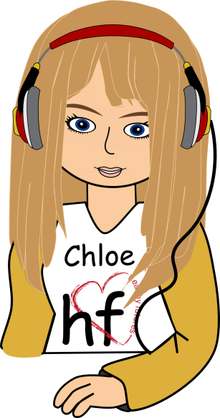


On Air
The Gabby & Chloe Show
Today’s topic:
Friendship Scenarios
Nu-CULTURE
Radio Station
Notes:
During the last session we talked about the keys to success. We said that to be successful in life, you have to know what you want and how to get there. You evaluated your own dreams, what it is going to take for you to get there on the journey to success, and you identified potential obstacles you might face. You are not going to be able to achieve your dreams on your own. You are going to need people to help you along the way. Those people will be family and friends. So, what kind of qualities and characteristics are important to have in these friendships to ensure that you are successful in achieving your dream?
I am going to read a couple of scenarios for you about different kinds of friendships. As I describe these different friendships, begin to think about how you would describe these friendships using descriptive words, qualities, and characteristics. Ask yourself if these are types of friendships worth having in your life. Are these friends going to help you achieve your dreams and be successful in life?

Slide 2
On Air
Joisevette and Keisha
Josivette has a friend named
Keisha. Keisha always gives
Josivette a hard time. She often
teases Josivette to the point
where Josivette feels
embarrassed and humiliated.
Nu-CULTURE
Radio Station

Slide 3
On Air
Joisevette and Keisha
Josivette feels as though Keisha often takes and takes in their friendship, but rarely gives anything back. Additionally, she has learned
that Keisha is making fun of her behind her back, which only adds
to her hurt feelings.
Nu-CULTURE
Radio Station

Slide 4
On Air
Describe Keisha
Selfish/Greedy
Hurtful
Destructive
Discouraging
Mean Spirited
Nu-CULTURE
Radio Station
Notes:
Ok, now that you have heard Friendship One, let’s talk about how you would describe it.
[Allow participants time to respond. Potential responses might include selfish/greedy, destructive, hurtful, mean-spirited, or discouraging.]

Slide 5
On Air
Marcus and Jose
Marcus enjoys being around his friend Jose. Jose has a great sense of humor and could be classified as a class clown. He is also well-liked by his classmates. He and Marcus don’t have a very deep relationship, but they do have fun together.
Healthy Futures
Radio Station
Nu-CULTURE
Radio Station

Slide 6
On Air
Describe Jose
Loves People
Funny
Leader
Popular
Outgoing
Entertaining
Nu-CULTURE
Radio Station
Notes:
Ok, now that you have heard Friendship Two, let’s talk about how you would describe it.
[Allow participants time to respond. Potential responses might include funny, entertaining, or popular.]

Slide 7
On Air
Leah and Selina
Leah and Selina are best friends. Leah feels like she can completely trust Selina with anything that
is going on in her life. She knows that Selina will always be there
to listen to her, support her, and
offer helpful advice.
Nu-CULTURE
Radio Station

Slide 8
On Air
Leah and Selina
Selina encourages Leah
in her goals, hobbies,
and interests. Leah
feels like she can be
herself around Selina.
Nu-CULTURE
Radio Station

Slide 9
On Air
Describe Selina
Helpful
Encouraging
Good Listener
Trustworthy
Supportive
Loyal
Nu-CULTURE
Radio Station
Notes:
Ok, now that you have heard Friendship Three, let’s talk about how you would describe it.
[Allow participants time to respond. Potential responses might include good listener, helpful, loyal, encouraging, supportive, or trustworthy.]
If you had to choose one friend, which one would it be? (Friendship Three.)
As we were reading these scenarios, did you have friendships of your own that came to mind?
If you have people in your life like the one described in Friendship One, do you think these people will help you succeed in life? (No.) What about Friendship Two? (Maybe.) There is nothing wrong with having fun friendships and being around people that make us laugh. However, as we mentioned earlier, we all need people to help us in life to be successful and achieve our dreams. Most likely, you are going to need the help of a friend like the one described in scenario three. This is a friend worth having. This is a friendship established on trust, respect, communication, support and encouragement.

Slide 10
On Air
Remember…
The choices you make
NOW
will affect you
LATER!
Nu-CULTURE
Radio Station
Notes:
This includes your choice of friends.

