Slide 1


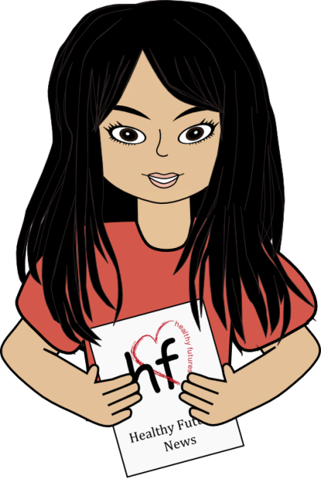
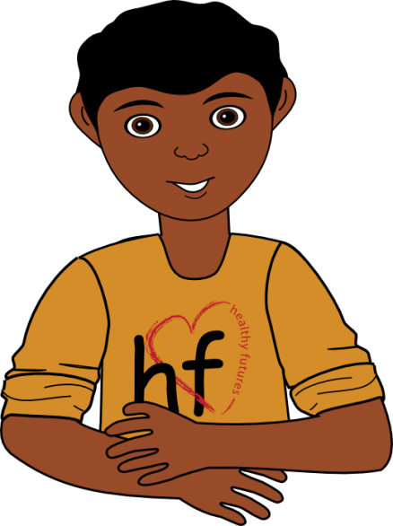

On Air
Breaking news…
Stress, Emotional Needs
& Positive Personal
Character Traits
Lana
Damian
Nu-CULTURE
News Station

Slide 2
On Air
Stress and Emotional Needs
List the top 5 things that cause you stress.
How do you normally handle stress?
What emotions do you feel when you are stressed, and how do you express those emotions?
Lana
Damian
Nu-CULTURE News Station
Notes:
Please take out a piece of paper and write down the top five things that cause you stress. Then evaluate how you would normally handle or react to stress. List the emotions you feel when you are stressed and describe how you express those emotions.
[Ask for individuals to share their responses to the questions and engage the class in discussion.]

Slide 3
On Air
Stress and Emotional Needs
What stressors did you see in the video?
How are each of these stressors affecting the character in the video?
What could have been done to meet some of the emotional needs in a healthy way?
Lana
Damian
Nu-CULTURE
News Station
Notes:
The girl in the video had several big stressors in her life. What stressors do you think she is experiencing?
[Allow time for participants to respond. Potential answers include fighting with her boyfriend, depression.]
Now, thinking about these stressors, tell me how they may be affecting her.
[Allow time for participants to respond.]

Slide 4
On Air
Stress and Emotional Needs
List some healthy ways to handle stress.
Lana
Damian
Nu-CULTURE
News Station
Notes:
Ok, now, let’s brainstorm a list of healthy ways to handle stress.
[Allow time for participants to respond. List may include: hobbies, exercising, spending time outdoors, spending time alone to clear your head, spending time with friends, managing time wisely to meet deadlines, setting boundaries in your life and dividing up priories (e.g., family, school, work, friends, extracurricular activities, etc.), taking care of your body, and identifying the stress relievers that work best for you.]
The character in the video had several big stressors in her life. We also learned that these stressors detracted from her physical and emotional needs being fulfilled. She wanted to give up. However, we have talked about several healthy alternatives to coping with stress in a positive way. It is important for you to find what works best for you since everyone is different. Remember, there are a lot of healthy ways to manage stress and trusted adults to turn to. Hurting yourself should never be the solution.
(Educator highlight: The topic of depression and suicide may come up in discussion. It is important to offer help to anyone who may be struggling with these issues. Provide the number to a local hotline for teens wrestling with suicidal thoughts. In order to avoid anyone feeling singled out or uncomfortable, request that everyone in the class take down the phone number.)
If you or someone you know is struggling with depression and/or suicidal thoughts, please seek out help. Here is the number of a hotline that will be able to talk things out with you: 1-877-968-8454. I am going to ask that everyone pull out a piece of paper and pen/pencil and write this number down regardless of whether or not you feel you need to use it. You may not need it, but you may be able to provide it to someone who does.

Slide 5
On Air
Stress and Emotional Needs
Positive Personal Character Traits
Keep your word
Avoid gossip
Try to do the right thing
  (even when no one is looking)
Avoid risky behaviors
Lana
Damian
Nu-CULTURE
News Station
Notes:
Stress is part of life. We can’t always avoid stressors but we can work on developing our positive personal character traits and avoiding unnecessary stressors. By focusing on your positive traits you will find yourself better able to avoid drama or handle it when you are faced with it.
If we always keep our word, we will avoid the stress of strained relationships with people who are upset that we did not follow through with our actions.
If we avoid gossip, then we will not have to worry about hurting our friends or family members by spreading hurtful things, or tearing others down.
If we always try to do our best, then we will not feel unnecessary stress or pressure to perform better because we know we put forward 100%.
If we avoid risky behaviors then we do not need to worry about our actions or the potential negative consequences.
[Play Teen Interviews on Stress video.]

Slide 6
On Air
And remember…
The choices you make
NOW
will affect you
LATER!
Lana
Damian
Nu-CULTURE
News Station

