Slide 1


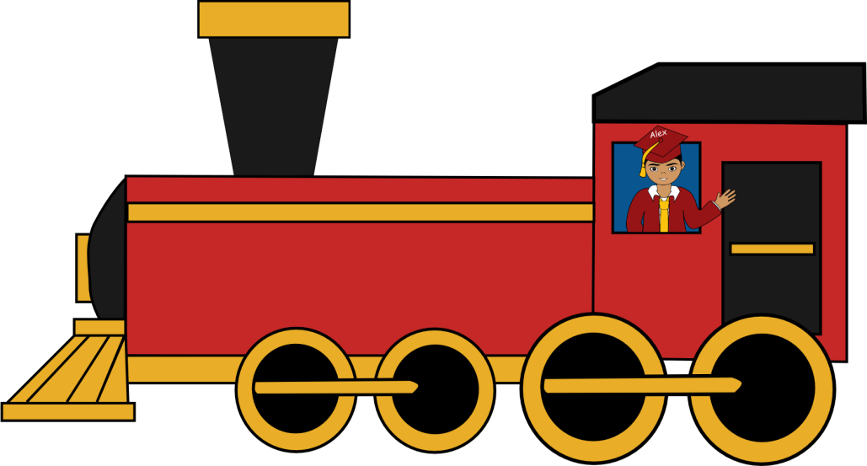




Train Track
Activity
Boston
New York
Session 8.1.7 Train Track Activity
Notes:
Now, we’re going to do another activity. What are these lines illustrating in the PowerPoint?
[A train track.]
Right! Let’s say this train is leaving _______________ (name of the city where you are teaching) and headed to _______________(New York City or other major city).
[Type the current city name next to the train and destination at the top of the track.]
What is the fastest way for this train to get to its destination?
[In a straight line, directly up, etc.]
[Advance slide to show arrow from the city name toward the destination.]

Slide 2
Train Track
Activity
Boston
New York
Off
Track
Session 8.1.7 Train Track Activity
Notes:
But what happens if the train gets derailed (e.g., gets off track)?
[Advance slide to show train off track.]

Slide 3
Train Track
Activity
Boston
New York
On
Track
Session 8.1.7 Train Track Activity
Notes:
If the train gets derailed, can it still get to its destination?
[Yes.]
Will the train get there on time?
[No.]
Will the passengers be frustrated?
[Yes.]
What has to happen for the train to get to its destination?
[Get back on track.]
[Advance slide from the derailed train back to the track.]

Slide 4
Train Track
Activity
Us
Goals & Dreams
Session 8.1.7 Train Track Activity
Notes:
The same thing can happen in our lives. Let’s think of ______ (name of the city where you are teaching) as us.
[Write us next to city name.]
And let’s think of our train’s destination as our goals and dreams.
[Advance slide to goals and dreams next to the destination at the top of the train track.]
What is the best way for us to achieve our goals and dreams?
[In a straight line, directly up, etc.]

Slide 5

Train Track
STD/
STI
Activity
Substance
abuse
Negativity
Emotional
heartache
Drugs
Us
Off
Track
Goals & Dreams
Stress
Early
sexual
activity
Alcohol
Teen
pregnancy
Session 8.1.7 Train Track Activity
Notes:
Yes. So we know the best way for us to achieve our goals and dreams is to stay on track and stay focused. But we also know there are things that can get us off track in life. What are some things that can happen in life that could get us off track and distract us from our goals and dreams?
[Drugs, alcohol, negativity, early sexual activity, teen pregnancy, STD/STI, emotional heartache, stress, substance abuse, etc.]
Right. Many of these things can distract us from our goals and dreams and derail us from our path. Sometimes we hear about negative relationships that can get you off track. If someone makes a decision and gets off track, does that mean they can’t achieve their goals and dreams?
[No.]

Slide 6
Train Track
STD/
STI
Activity
Substance
abuse
Negativity
Us
Emotional
heartache
Drugs
On
Track
Goals & Dreams
Stress
Early
sexual
activity
Alcohol
Teen
pregnancy
Session 8.1.7 Train Track Activity
Notes:
What do they have to do?
[Get back on track.]
As we discussed earlier, Healthy Futures activities always have a meaning. The meaning behind this activity is when you get off track, you have two choices. You can choose to stay off track and potentially go even further off track, or you can choose to get back on track and continue to focus on your goals and dreams. But that is your choice.
These are the types of decisions you have to make in life. Obstacles are going to come along but it is your choice how you deal with them. For example, if you choose to become sexually active at a young age, it can definitely get you off track and make it a lot harder to achieve your goals and dreams. It is a decision you have to make. At Healthy Futures we believe the healthiest lifestyle for teenagers is to delay sexual activity. But it all comes down to your choice.
And…The choices you make…NOW will affect you…LATER!

