Slide 1
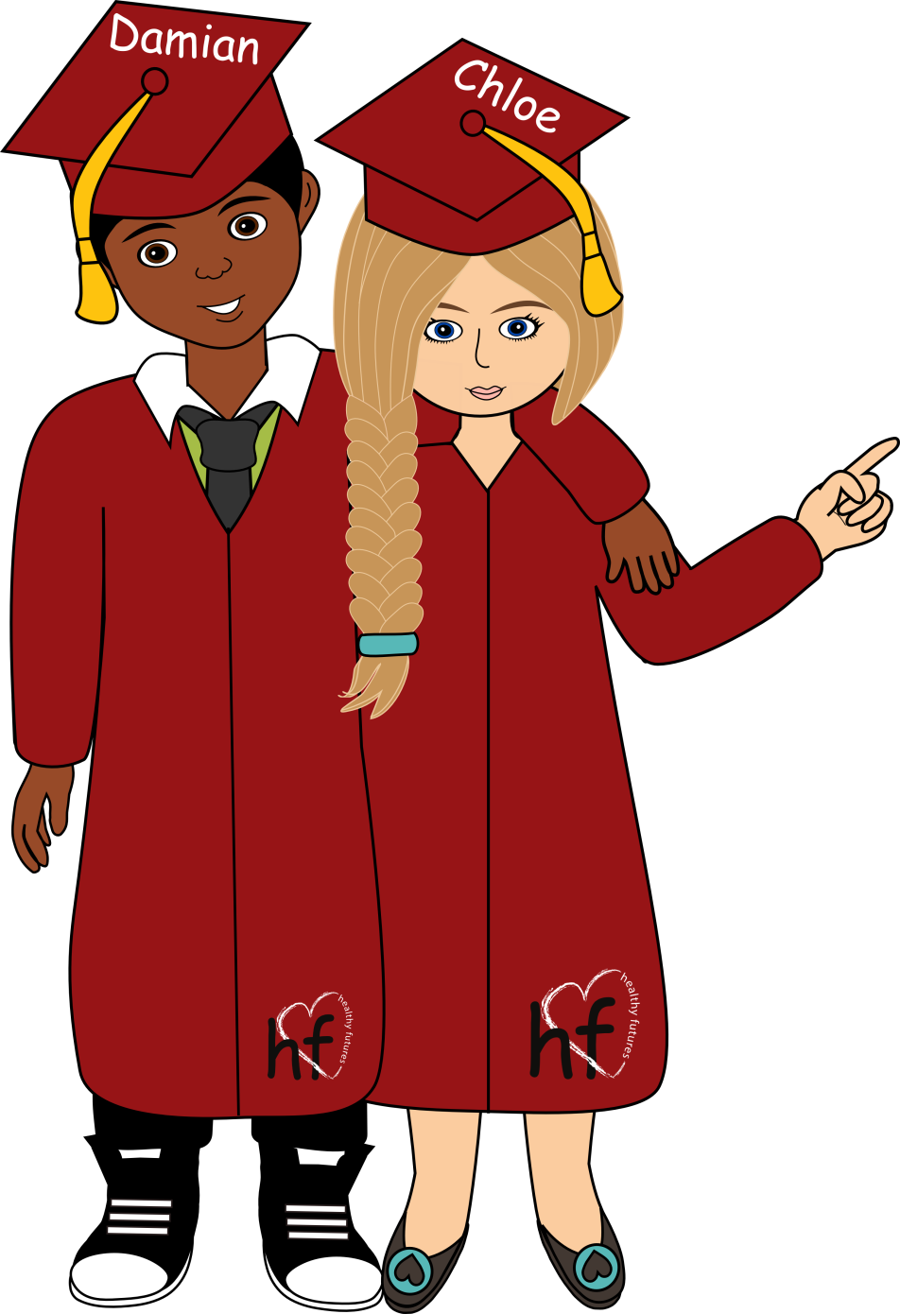

Changes in Puberty

Slide 2
Physical Changes
Biological Males
Biological Females
Grow Taller
Grow Taller
Facial Hair
Breast Growth
Shoulders Broaden
Hips Widen
Notes:
Let’s start with the physical changes. Think back to the changes we discussed in 6th and 7th grade. What kinds of changes may be happening to your bodies during puberty?
[Take time to hear from participants. Write answers in on the board.]
Biological Males:
Grow taller
Facial hair
Shoulder broaden
Biological Females:
Grow taller
Breast growth
Hips widen

Slide 3
Physical Changes
Emotional Changes
Changes in interests
Changes in relationships
with friends
Changes in relationships
with parents/family
Notes:
As we discussed in 6th and 7th grade, a lot of changes happen during puberty. Let’s list some of the changes that happen:
Physical changes
Emotional changes
Changes in interests
Changes in relationships with friends
Changes in relationships with parents/family
[Take time to hear from participants. Write answers in on the board.]

Slide 4
Puberty Review
Time of growth and change
  10 to 18 years old in biological boys
  9 to 17 years old in biological girls
Glands in body start making hormones causing:
  Body changes
  Emotional changes
  Sexual thoughts and feelings
Notes:
Let’s review some puberty facts:
Puberty is a time of growth and change.
It can start anytime 10 to 18 years old in biological boys and from 9 to 17 years old in biological girls.
During puberty the glands in the body start making hormones that cause many physical and emotional changes. The body begins to grow and mature, gains the ability to reproduce, and sexual thoughts and feelings begin to occur.

