Slide 1
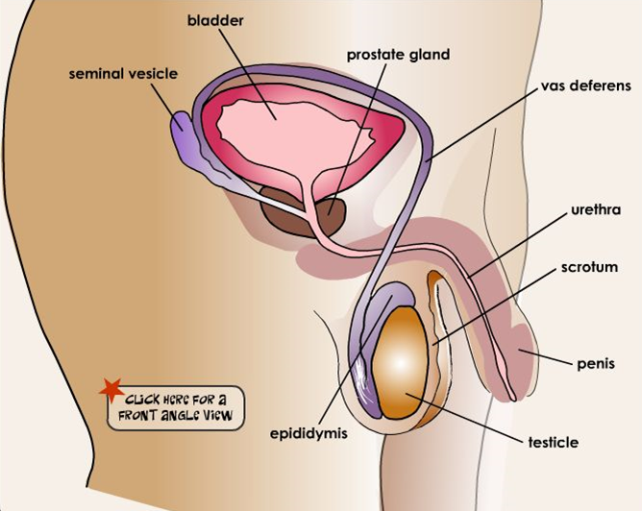

The Male Reproductive System
© The Nemours Foundation/KidsHealth. All rights reserved.
Reprinted with permission
Notes:
First we are going to do a quick review of the biological male reproductive system. This slide shows the biology of the male reproductive system.
Biological males have two testicles, one on each side, and the process is the same for both. The testes create sperm. They also create the chemical testosterone. Testosterone is the male hormone that helps maintain the male sexual characteristics (facial hair, deep voice, etc.).
The testes are located in the scrotum or scrotal sac, the loose pouch-like sac of skin located behind and below the man’s penis (hangs under the penis). Also found in the scrotum is the epididymis (right next to each testicle).
As sperm are being produced (several hundred million a day), they pass from the testes through a tightly coiled tube known as the epididymis. This is where the sperm is stored and matures until they are ready to be transported through a tube called the vas deferens. Now that the sperm is mature (a process of about 72 days from the time they are formed), they move through the vas deferens. The vas deferens is also called the ductus deferens. It is a thin long tube that transports sperm from the epididymis to its final destination, the urethra. But before that, it needs to pass through very important glands.
The first glands are the seminal vesicles. They are two pouch-like glands that produce and secrete fluid into the ejaculatory ducts. This fluid provides sperm with a source of energy and helps with the sperm’s motility. They are located at the base of the bladder (the bladder is the sac that stores your urine). So the job of the vesicles is to release a thick, sugar-like fluid that nourishes the sperm (in other words, feed and energize sperm).
The sperm travels from the seminal vesicles to another important gland called the prostate gland. The prostate gland produces some of the fluids in semen. The prostate gland releases thin, milky colored fluid that enhances the motility of the sperm.
Finally, we have the penis. The penis is made of two parts: the shaft (which is the main part) and the glans (also known as the tip, sometimes called the head). The penis releases sperm or semen through a process called ejaculation. Ejaculation is the release of semen from the penis. Also, inside the penis is the urethra, which is the tube that carries semen or urine out of the penis.

Slide 2
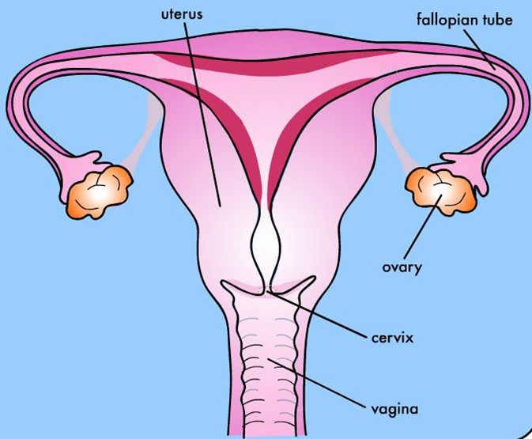
The Female Reproductive System
© The Nemours Foundation/KidsHealth. All rights reserved.
Reprinted with permission
Notes:
Now let’s look at the biology of the female reproductive system. This slide shows the biology of the female reproductive system.
There are two ovaries. The ovaries are located in the left and right lower abdomen. Their function is to release eggs as well as hormones like estrogen and progesterone. These chemicals give biological women their female characteristics (such as breasts, wider hips, menstrual period, etc.).
There are also two fallopian tubes. There is one tube associated with each ovary. These thin, soft tubes extend from the uterus and end close to the ovaries. Because there is no connection between the fallopian tubes and the ovaries, at time of ovulation the fingerlike structures at the end of the fallopian tubes create a current to help move the egg from the ovary to the fallopian tube. Once inside the fallopian tube, millions of tiny, hair-like cilia move the egg through the fallopian tube toward the uterus. If a biological female engages in vaginal sex with a male around the time of ovulation, this is where the sperm of a biological male will meet with the egg in a process called fertilization.
The egg next enters the uterus. It’s a stretchy muscle where a baby might grow one day. It is also called the “womb.” The uterus is a hollow, pear-shaped organ with a muscular wall and a lining. The uterus expands many times in size during pregnancy to hold the growing fetus (meaning it becomes larger as the baby grows). At the lower part of the uterus is a small opening called the cervix, which opens into the vagina. The vagina is a tube-like organ that connects the vagina to the outside of the body.

Slide 3
Pregnancy
© The Nemours Foundation/KidsHealth. All rights reserved.
Reprinted with permission
Notes:
The vagina is where vaginal intercourse takes place and is the birth canal during childbirth. When a biological male ejaculates, it may happen here. If a biological male ejaculates in or near the biological female’s vagina, the sperm may make its way up to the fallopian tubes and fertilize the egg. Sperm can live in the biological female body for up to five days. A fertilized egg moves into the uterus and implants in the lining. There the baby grows until it is ready to be born. During labor (the process of childbirth), the cervix dilates (expands to about 4 inches or 10 centimeters in diameter) to allow the baby to leave the uterus through the vagina (birth canal) and exit the mother’s body.
Now that we have reviewed how a pregnancy occurs, let’s see how much you remember. We are going to break you up into several groups and see which group can be the first to win the “Pregnancy Scramble” game.

Slide 4
Why do some teens get pregnant?
They don’t know the facts.
They don’t think it will happen to them.
They don’t know the risks of sexual activity.
They think having a child will help keep their boyfriend or girlfriend.
Sex was not planned, it just happened.
© 2013 , 2023 Healthy Futures
Notes:
Just because your body is ready for pregnancy, does that mean that you are ready to have a child?
[No.]
There is a lot of responsibility that comes along with having a child. So why do some teens become pregnant if they are not ready to have a child?
[They don’t know the facts; they think it can’t happen to them; don’t know the risks of sexual activity; they think having a child will help keep their boyfriend or girlfriend; sex is not planned, it just happened.]
Right. For many teens, they might not know the facts about puberty and pregnancy or maybe they don’t think that it will happen to them. Additionally, even if some teens know about puberty and pregnancy they might not know the risks of sexual activity. Who can remind us what the three risks and dangers of sexual activity are?
[Pregnancy/Fathering a child, sexually transmitted infections (STIs), and emotional heartache.]
Sometimes teens become pregnant because sex was not planned and it just happened. Other times teens think having a child will help them keep their boyfriend or girlfriend.

Slide 5
Important to Remember!
Pregnancy can occur after having vaginal sex just one time.
Sperm can live in the female’s body for up to five days after it has been released into the vagina or onto the vulva (external female genitals).
Getting pregnant as a teen can have a major impact.
© 2013 , 2023 Healthy Futures
Notes:
It’s important to remember:
Pregnancy can occur after having vaginal sex just one time.
Sperm can live in the female’s body for up to five days after it has been released.
Getting pregnant or getting someone pregnant in your teens can have a major impact both partners’ lives.

