Slide 1
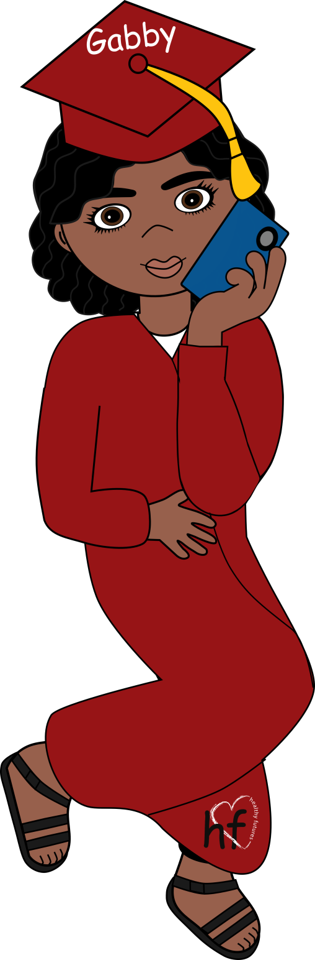










What’s healthy, what’s not?
3:40PM
x
Who’s Online:
Nu-CULTURE
Alex
Chloe
Damian
Conversations
Gabby
Lana
Austin

Slide 2



3:40PM
Support
x
Who’s Online:
Nu-CULTURE
I don’t understand
this math homework.
Alex
Chloe
Damian
Here, let me help you with it.
Gabby
Lana
Austin

Slide 3


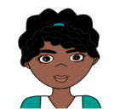
3:40PM
Jealousy
x
Who’s Online:
Nu-CULTURE
I just called her to invite her to the party. Everyone’s going.
Alex
Chloe
Damian
Gabby
I don’t want you to call
her ever again!
Lana
Austin

Slide 4


Pressure
3:40PM
x
Who’s Online:
Nu-CULTURE
Alex
Oh, come on, you should have a beer. Everyone else is drinking.
I really don’t want to…
Chloe
Damian
Gabby
Lana
Austin

Slide 5
Name-Calling
3:40PM
x
Who’s Online:
Nu-CULTURE
Alex
Chloe
Damian
You are so stupid!
Gabby
Lana
Austin

Slide 6
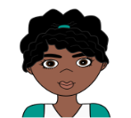
Affection
3:40PM
x
I sent it because I care about you.
Who’s Online:
Nu-CULTURE
Alex
Chloe
Damian
Gabby
I love that card! It was
so sweet and thoughtful.
Lana
Austin

Slide 7

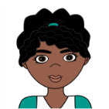
Honesty
3:40PM
x
Who’s Online:
Nu-CULTURE
Alex
Well, is that what
you really think?
Chloe
Damian
Gabby
You know I always tell you the truth about what’s on my mind.
Lana
Austin

Slide 8
Control
3:40PM
Give me your phone! I want to know who you have been talking to.
x
Who’s Online:
Nu-CULTURE
Alex
Chloe
Damian
No! That’s none of your business.
Gabby
Lana
Austin

Slide 9

3:40PM
Abuse
x
If you hadn’t made me so mad, I wouldn’t have hit you.
Who’s Online:
Nu-CULTURE
Alex
Chloe
Damian
Gabby
Lana
Austin

Slide 10
Equality
3:40PM
x
Who’s Online:
Nu-CULTURE
Alex
But I really want to see this new movie. Everyone is saying it’s amazing!
Chloe
Damian
Gabby
I really don’t want to go to
the movies today. It’s nice out,
we should go for a walk!
Lana
Austin
I know. Why don’t we go for a walk today after school and then the movie on Saturday?

Slide 11
Communication/Respect
3:40PM
What do you mean you’re not ready? We’ve been dating for 6 months!
x
Who’s Online:
Ok. I can respect that. I really enjoy hanging out with you too.
Nu-CULTURE
Alex
Chloe
Damian
I know you want to have sex but I’m not ready.
Gabby
Lana
I know. But we are in middle school and I want to wait until I am older to have sex. Can we continue hanging out without sex? I am so happy with how things are now and really enjoy spending time with you.
Austin

