Slide 1

Limits
Notes:
How many of you have ever been on a diving board? What’s it like as you start walking towards the edge of the diving board?
Does it get more or less bouncy?
[More bouncy.]
Can you walk all the way out to the very edge of the diving board and not fall in?
[Maybe/No.]
You probably can, but you can lose your balance pretty easily, right?

Slide 2
sexual activity
Notes:
This diving board is an illustration about sexual activity as a teen. In this scenario going off the diving board represents being sexually active before a faithful lifelong relationship.

Slide 3
emotional
heartache
STI
pregnancy
Notes:
As we have discussed in 7th grade and earlier this week, there are three risks associated with sexual activity outside of a faithful lifelong relationships. Can someone name the three risks?

Slide 4
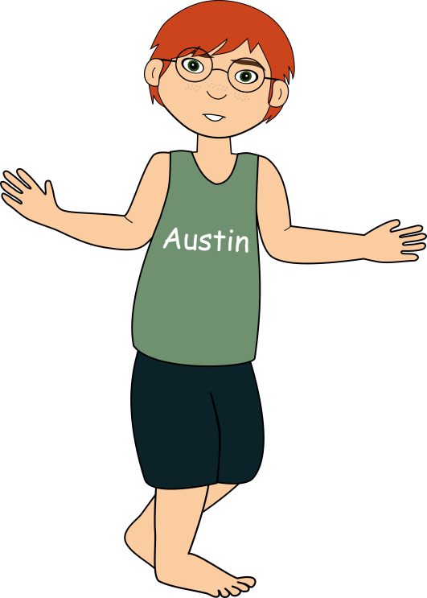
emotional
heartache
STI
pregnancy
Notes:
[Pregnancy/Fathering a child, STIs, emotional heartache.]
So, thinking about this illustration more, as physical contact progresses in a relationship, does it get easier or harder to stop and say no to sexual activity?
[Harder.]

Slide 5
emotional
heartache
STI
pregnancy
Notes:
Harder, exactly. That’s like walking out on the diving board. The further out you are, the easier it is to go into the pool. Now, if you’re on a diving board, if you lean out, can you still stand back up and walk away from the edge?
[Yes but it can sometimes be hard.]

Slide 6
emotional
heartache
STI
pregnancy
Notes:
Right. You can always stand back up, no matter how close you are to the edge. The same thing is true for sexual activity. You can always stop and go back to a place where you’re less likely to lose control.
What happens if you stay out on the edge? You may get tired of balancing or start to think how nice it would be to be in the pool with your boyfriend/girlfriend.

Slide 7
emotional
heartache
STI
pregnancy
Notes:
At Healthy Futures, this is what we recommend: set a limit for yourself.
Is it going to be more or less bouncy there?
[Less bouncy.]
Setting limits in relationships help you stick to your goal and delay sexual activity. The limit represents your personal limit for sexual activity (the new edge of the diving board that you won’t cross).
You have to set your own limits. No one can do it for you. This limit is different for everyone and is influenced by your parents, your values, your spiritual beliefs, and your friends. Choose your limits carefully and remember the further out you are on the diving board, the more bouncy it’s going to be.
Now, what would happen if this person, in a moment of passion goes further than the limit they had set for themselves?
Do they fall into the pool?
[No.]
They can go back to the other side of their limit pretty easily.
What about the person out here on the edge?
[Point to the person on the end and draw arrows over the limit line into the pool.]

Slide 8
emotional
heartache
STI
pregnancy
Notes:
Would he/she fall into the pool?
[Yes.]
Right, just like Austin, they’ll fall in.
Let’s talk about that for a minute. If they’re in this pool, do they need to keep swimming around in there?
[No.]
Right. They can get out and rethink their limits.

Slide 9
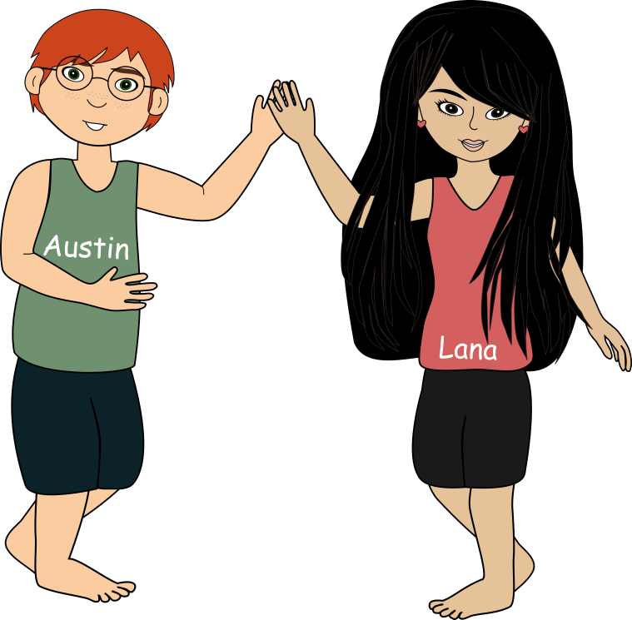
emotional
heartache
STI
pregnancy
Notes:
The exciting news is that if you thoughtfully set your limits as a teen, when you are older and in a faithful lifelong relationship, you’ll be standing on the diving board with your partner, ready to jump off together. All of the risks will be gone.

Slide 10
The choices
you make NOW
will affect
you LATER!
Notes:
You will be able to fully enjoy sexual activity without the risks of unintended pregnancy (if you are trying to have a child/using contraception), STIs, or emotional heartache!

