Slide 1
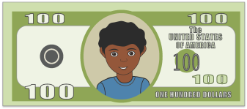




What Are They REALLY
Trying to Sell?
25
Credit Card
25
Credit Card
5
1
4444 5555 6666 7777
1
Exp 12/2020
10
4444 5555 6666 7777
Exp 12/2020
© 2013, 2023 Healthy Futures

Slide 2
What are they Really Selling?
What product do you think _______is selling in this advertisement?
What message is this company communicating to their consumers?
Insert advertisement here
Notes:
That is the way that advertisements are used to influence the way we think. They want to make you think that if you use this product you will be gorgeous, sexy, and rich and have all the guys or girls running after you. Is that really true?
[No.]

