Slide 1

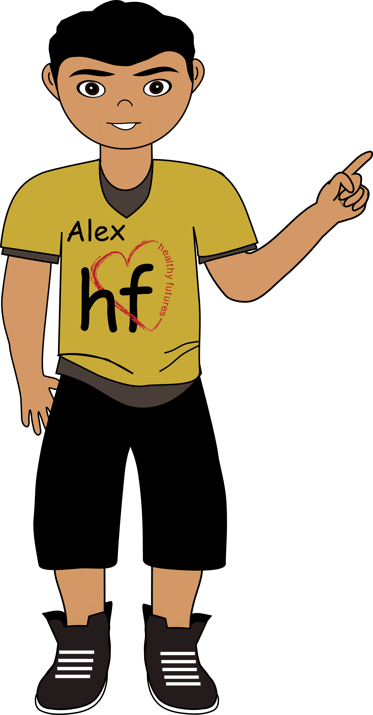


Healthy Futures
STIs
Sex
STIs by the numbers
The sexual revolution
Types
Condoms
CDC
It’s your
choice
STIs
STIs
Sexually Transmitted Infections
Notes:
STI stands for Sexually Transmitted Infection. This means contracting some form of infection as a result of sexual contact with another person. Sexual contact means any contact with reproductive organs. Sometimes people talk about Sexually Transmitted Diseases (STDs). It is important to understand the difference between STI and STD. As we said, STD stands for Sexually Transmitted Disease. This term has been used for a long time. STI is a newer term that stands for Sexually Transmitted Infection. STI is now the standard term used by doctors and the Centers for Disease Control and Prevention (CDC). STI is used because when you have a disease, it usually means that you have signs or symptoms of an infection, but as we said earlier, many sexually transmitted infections have no symptoms. So, often people don’t even know they have them. Since infections don’t always cause symptoms, some people think the term STD can be confusing. For this reason, we will use the term STI.

Slide 2
Healthy Futures
STIs
Sex
STIs by the numbers
The sexual revolution
Types
Condoms
CDC
It’s your
choice
Sex
Sex
Any type of private
area contact
Vaginal sex (intercourse):
Involves inserting the penis
into the vagina
Anal Sex: Sexual contact with partner’s anus
Oral Sex: Mouth to
private area
Outercourse: Private area
contact without penetration
Notes:
What counts as sexual contact? Most of the time when people hear sex, they think of (1) vaginal sex (intercourse) - which involves a male inserting his penis inside a female’s vagina. However, sexual activity also includes: (2) oral sex, which is when a person’s mouth comes in contact with his or her partner’s private area, (3) anal sex, which is any contact with a partner’s anus, (4) or outercourse, which is when the private areas of a couple come in contact, but there is no penetration by the male’s penis. Just remember that sex is any type of private area contact; you can get an STI from doing any of these things. It doesn’t matter if you are male or female, old or young, if it’s your first time having sex or your millionth time having sex, you can still get an STI if you engage in sexual activity without a barrier (we will talk more about that later in today’s session).

Slide 3
Healthy Futures
STIs
Sex
STIs by the numbers
The sexual revolution
Types
Condoms
CDC
It’s your
choice
STIs by the numbers
STIs by the numbers
In the US, how many new cases of STIs
do you think happen each year?
1,900
19,000
About 190,000
About
26,000,000
How many of these are among people between the ages of 15 and 24?
10%
About 25%
About 50%
Notes:
STIs are a serious problem. The US has the highest rates of STIs among countries with access to good healthcare. In the US, how many new cases of STIs do you think happen each year?
[Allow participants time to guess. Answer: About 26,000,000.]
How many of these are among people between the ages of 15 and 24?
[Allow participants time to guess. Answer: About 50%.]

Slide 4
Healthy Futures
STIs
Sex
STIs by the numbers
The sexual revolution
Types
Condoms
CDC
It’s your
choice
The sexual revolution
The sexual revolution
Before the 1960’s, there were two known types
of STIs and both were curable.
The invention of the birth control pill led to increased
experimentation with multiple partners.
Multiple sexual partners increases the
risk of spreading STIs.
Now there are over 25 known STIs,
many of which have no cure.
Notes:
Why are STIs such an issue today? Well, partially because of something called the sexual revolution. Who has ever heard of the American Revolution? It’s not the same thing. Back before the 1960s, there were two known types of STIs and both were curable; you could get medication from the doctor. If you aren’t worried about STIs, what are you worried about?
[Pregnancy.]
Well, in the 1960s the birth control pill was invented. Because people were less worried about pregnancy, they started experimenting with multiple sexual partners. However, as we saw in the star activity, having multiple sexual partners increases a person’s chance of getting an STI, and now there are over 25 known STIs, many of which have no cure.

Slide 5
Healthy Futures
STIs
Sex
STIs by the numbers
The sexual revolution
Types
Condoms
CDC
It’s your
choice
Types
Types
Bacterial STIs
Usually curable.
Includes syphilis, gonorrhea, and chlamydia.
If left untreated, gonorrhea and chlamydia may lead to pelvic inflammatory disease (PID).
Viral STIs
Not curable. But in most cases, HPV goes away on its own and does not cause any health problems.
Includes human papillomavirus (HPV), genital herpes simplex virus, and human immunodeficiency (HIV).
Parasitic STIs
Curable.
Include trichomoniasis
Symptoms can range from mild irritation to severe inflammation. Without treatment, infection can last months or even years.
Notes:
There are three main types of STIs; bacterial, viral and parasitic. Bacterial STIs are usually curable, which means a doctor can give you antibiotics. However, doctors are now discovering that different strains of these infections are becoming resistant to medication, meaning the medication doesn’t always work. Bacterial STIs include syphilis, gonorrhea, and chlamydia. If you have had sex it is very important to get tested by a doctor; many of these diseases do not show symptoms immediately, and if left untreated, gonorrhea and chlamydia may lead to a serious condition called pelvic inflammatory disease.
Viral are the second type of STIs; viral STIs are not curable. Your body needs to fight it off on its own or you have the disease for life. Medication may be available to deal with symptoms, but it’s not a cure; you still have the disease and can pass it to others. Viral STIs include human papillomavirus, genital herpes simplex virus, and HIV, which can lead to AIDS. In most cases, HPV goes away on its own and does not cause any health problems.
Parasitic are the third type of STIs; parasitic such as trichomoniasis are curable. It can be treated with medication. Most people who have the parasite cannot tell they are infected. About 70% of infected people do not have any signs or symptoms. When it does cause symptoms, they can range from mild irritation to severe inflammation. People who have been treated for trichomoniasis can get it again. Without treatment, the infection can last for months or even years.

Slide 6
Healthy Futures
STIs
Sex
STIs by the numbers
The sexual revolution
Types
Condoms
CDC
It’s your
choice
Condoms
Condoms
A condom is a latex/rubber sleeve that fits over a male’s penis and is made to be a barrier so that sperm or infections can’t get passed between people during sex.
If used correctly, condoms will reduce risk of pregnancy and the transmission of HIV. Condoms will not provide protection against STDs spread by skin-to-skin contact (genital herpes or syphilis).
The consistent and correct use of latex (or polyurethane or polyisoprene if allergic to latex) condoms can reduce (though not eliminate) the risk of STD transmission. Natural or lambskin condoms also help prevent pregnancy, but may not provide protection against STDs, including HIV.
Correct use means a condom has to be worn correctly every time that you have sex and stored following directions on the package.
Notes:
Now we want to talk to you about condoms. A condom is a latex/rubber sleeve that fits over a male’s penis and is made to be a barrier so that sperm or infections can’t get passed between people during sex. A lot of times people refer to using condoms as safer sex or using protection. This is because condoms can be effective at reducing the chance of pregnancy and STIs.
Studies show that consistent use of condoms is highly effective in preventing the spread of HIV. Condoms can be expected to provide protection depending on the type of STD. They will provide protection against STDs spread by genital fluids (such as gonorrhea or chlamydia). Condoms will not provide protection against STDs spread by skin-to-skin contact (genital herpes or syphilis). Using condoms the right way every time you have sex can lower your chances of getting HPV. But HPV can infect areas the condom does not cover. So Condoms may not fully protect against getting HPV. If you or your partner have genital warts, stop having sex until you no longer have warts. We do not know how long a person is able to spread HPV after warts go away. Latex condoms must be used correctly and consistently to provide the best protection. If either partner is allergic to latex, polyurethane condoms are recommended. The use of natural membrane condoms for reduction of STIs and pregnancy is not recommended.
When condoms are used incorrectly or inconsistently:
STDs or HIV can spread from a single sex act with an infected partner.
Condoms can break, slip, or leak.
Pregnancy can occur.
If you choose to be sexually active in the future, consistent and correct use of a latex condom when engaging in any type of sexual activity (outercourse, vaginal, oral, or anal) reduces the risk of STIs (e.g., HIV) and consistent and correct use of latex condom when engaging in vaginal sex reduces the chance of pregnancy. So if you choose to be sexually active, you need to use a condom.

Slide 7

Healthy Futures
STIs
Sex
STIs by the numbers
The sexual revolution
Types
Condoms
CDC
It’s your
choice
Condoms
Condoms
Are
Don’t
Effective at reducing the risk of HIV/AIDS and some other STIs.
Prevent transmission of STIs spread by skin-to-skin contact, (genital herpes, syphilis, HPV)
Effective at reducing the risk of pregnancy.
Provide 100% effective at preventing pregnancy.
Notes:
Let’s sum it up: Condoms are: (1) effective at reducing the risk of HIV/AIDS and some other STIs because they create a barrier so that some STIs (not all) cannot be transmitted, (2) effective at reducing the risk of pregnancy, and (3) better than no method at all. If you are going to have sex, you should use a condom. Condoms don’t: (1) prevent transmission of STIs spread by skin-to-skin contact, (genital herpes, syphilis, HPV) (2) provide 100% effective at preventing pregnancy, and (3) protect your emotions (remember our activity with the hearts – condoms won’t protect you from a broken heart).

Slide 8
Healthy Futures
STIs
Sex
STIs by the numbers
The sexual revolution
Types
Condoms
CDC
It’s your
choice
CDC
This is what the CDC says:
“The surest way to avoid transmission of STIs is to abstain from sexual contact or to be in a long-term mutually monogamous relationship with a partner who has been tested and is known to be uninfected.”
Notes:
The CDC is the Centers for Disease Control, which is a place where they study diseases, how they affect our population, and how to prevent them. They say the surest way to avoid transmission of STIs is to abstain from sexual contact or to be in a long-term mutually monogamous relationship with a partner who has been tested and is known to be uninfected. Who knows what monogamous means? One person with one person for life. We say a faithful lifelong relationship.
If you choose to be in a sexual relationship and either you or your partner has been sexually active in the past (even once), it is important for you both to get tested (because the most common symptom of an STI is no symptom). If you are in a faithful lifelong relationship with someone who has an STI is it important to use a condom and talk to a medical professional to reduce the risk of STI transmission.

Slide 9
Healthy Futures
STIs
Sex
STIs by the numbers
The sexual revolution
Types
Condoms
CDC
It’s your
choice
It’s your choice
It’s your choice!
Practice abstinence
If you or your partner have ever been sexually active in the past (even once), it is important to get tested before engaging in any
type of sexual activity.
If you choose to be sexually active use a condom every time.
…Because the choices you make NOW will affect you LATER!
Notes:
Remember – what you do with this information is up to you. You choose whether or not to practice abstinence. And the choices you make NOW will affect you Later!

Slide 10
Healthy Futures
STIs
Sex
STIs by the numbers
The sexual revolution
Types
Condoms
CDC
It’s your
choice
Group work
Group work:
Get into your groups
Review the STI fact sheet
Get ready to present the material as if you were the teacher
Notes:
In a few minutes we are going to break you up into groups to look at a particular STI assigned to your group. You will review the information on the Facts about STIs (Handout 7.6.4) then your group will be responsible for presenting what you learn for the whole class. You are to present it as if you were the teacher of the class. You can present the material in a fun and creative way by creating your own character or personality for the teacher.
You will have 10 minutes to prepare as a group. Not everyone has to stand up and present your group's STI information to the rest of the class (you all can be teachers if you want), but be sure that everyone is at least involved in preparing for the presentation.

