Slide 1
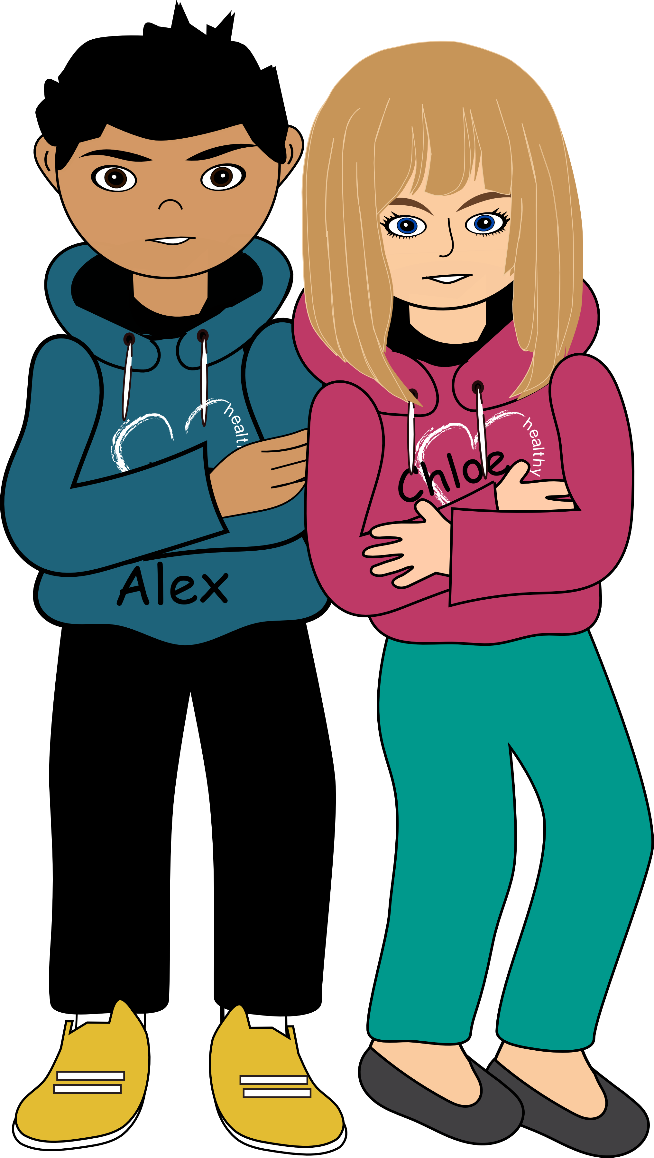

Nu-CULTURE
Conflict
Resolution
Session 6.7.2 Conflict Resolution
© 2013, 2023 Healthy Futures

Slide 2
What is conflict resolution?
When people
work together
to solve a
problem!
Session 6.7.2 Conflict Resolution
© 2013, 2023 Healthy Futures
Notes:
Conflict resolution is when people work together to solve a problem.

Slide 3
Have you ever had a fight
with someone?
What did they do?
Got you into trouble
Teased you or hurt
your feelings
Told your secrets
Session 6.7.2 Conflict Resolution
© 2013, 2023 Healthy Futures
Notes:
Have you ever had a fight with a friend or a sibling? What did they do to upset you?
Did they:
Get you into trouble
Tease you or hurt your feelings
Tell your secrets

Slide 4
How did you respond?
How did you feel?
What did you do?
What did you say?
Session 6.7.2 Conflict Resolution
© 2013, 2023 Healthy Futures
Notes:
(Let student tell their story, answering each of the questions on the slide.)
How did you respond?
Did you feel angry or hurt?
Did you yell or ignore the other person.
What did you say to them?
It’s natural to feel hurt or angry when we’re disagreeing with someone. But it’s important to always try and resolve the problem.

Slide 5
We can choose how to respond to a conflict!
We have 3 choices:
Aggression:
Getting our own way
Avoidance:
Pretending the
argument never happened
Negotiation:
Talking about the problem and
agreeing on a solution
Session 6.7.2 Conflict Resolution
© 2013, 2023 Healthy Futures
Notes:
There are three ways that a person can respond when it comes to conflict. Let’s look at them;
First, we have aggression, this is getting your own way.
Second, avoidance, this is pretending the argument never happened.
And third, negotiation, this is talking about the problem and agreeing on a solution.
So what we are going to do now is try each of these out in a scenario. I want you all to pay attention and see if you can decide which of the three is the best way to handle a conflict.

Slide 6
Don’t take my chips!
Chloe and her brother John both love chips.
But John always takes Chloe’s chips without asking. Usually she lets it go, but this time she was really looking forward to enjoying them. When she went to the kitchen to get the bag
of chips, it was gone. By the time John came
home, Chloe was really ANGRY.
How would Chloe solve
this with aggression?
Chloe: You stole my chips!
Session 6.7.2 Conflict Resolution
© 2013, 2023 Healthy Futures
Notes:
Chloe and her brother John both love chips. But John always takes Chloe’s chips without asking. Usually she lets it go, but this time she was really looking forward to enjoying them. When she went to the kitchen to get the bag of chips, it was gone. By the time John came home, Chloe was really ANGRY.
Educators act out skit using aggression:
Chloe: You stole my chips!
John: No I didn’t they were mine.
Chloe: No you stole my chips and I am going to punch you in the face.
John: But
Chloe: (Interrupting John) Oh Shut up John, you always steal my stuff and I am telling mom.
John : But
Chloe: (Interrupting John) I don’t care about what you have to say…..(Shouts) La, la, la, la!!

Slide 7
Getting your own way no matter what
1. Aggression
Becomes violent
Blames the other person
Becomes angry
Doesn’t listen
Session 6.7.2 Conflict Resolution
© 2013, 2023 Healthy Futures
Notes:
How did Chloe use aggression as a way to resolve this conflict?
After the argument, how do you think John felt? (Frightened, used, disrespected, don’t agree but did it their way, etc.)
Do you think John was heard?
Did the problem get Resolved?
Now we are going to look at the same scenario using avoidance as the way to solve the conflict.
Educators act out skit using avoidance:
Chloe: You stole my chips!
John: No I didn’t, they were mine.
Chloe: If you say so.
John: But I saw them in….(getting annoyed) Hey where are you going?
Chloe: (Walking away) I don’t want to fight with you.
John: We're not fighting.
Chloe: (speaking softly) I just don’t want to talk about it.
John: (Yelling out to her back) But!!
Chloe: (Leaves the room.)

Slide 8
Don’t take my chips!
How would Chloe solve
this with avoidance?
Chloe: You stole my chips!
Session 6.7.2 Conflict Resolution
© 2013, 2023 Healthy Futures

Slide 9
Pretends that everything is okay
2. Avoidance
Allows others to
be in control
Speaks softly or uncertainly
Keeps feelings/opinions to self
Pretends to agree
Session 6.7.2 Conflict Resolution
© 2013, 2023 Healthy Futures
Notes:
Why would Chloe use avoidance to respond to John? (fear, dislikes conflict, to get the situation over with quickly, etc.)
Was Chloe ever really heard by John?
Do you think John clearly understands Yolanda’s point of view?
Do you think Chloe respects herself?
Did this technique solve the problem

Slide 10
Don’t take my chips!
How would Chloe solve
this with negotiation?
Chloe: You stole my chips!
Session 6.7.2 Conflict Resolution
© 2013, 2023 Healthy Futures
Notes:
Now we are going to use negotiation to solve Chloe and John’s conflict.
Educators act out skit using negotiation.
Chloe: You stole my chips!
John: Are you sure they were yours? I thought they were mine.
Chloe: (Thinking) Hummm… Maybe that’s because they were close together.
John: Ya, I should have asked which one was your and which one was mine.
Chloe: Well in the future let’s agree to put our chips in different places.
John: That is a good idea, that way we won’t get confused.
Chloe: Yeah!

Slide 11
Working together to find a solution
3. Negotiation
Shares feelings & opinions
Speaks directly, but kindly
Is honest and fair
Listens
Session 6.7.2 Conflict Resolution
© 2013, 2023 Healthy Futures
Notes:
How do you think negotiation worked?
Do you think Chloe’s response kept everything calm? Why?
Do you think this technique solved the problem? Why

Slide 12
Negotiation!
The best response…
Session 6.7.2 Conflict Resolution
© 2013, 2023 Healthy Futures
Notes:
So what do you all think the best way to resolve a conflict is?
(Wait for students to respond)
YES!! Negotiation

Slide 13
Steps to Resolving Conflict
1. Control your emotions.
2. Try to understand
the other side.
Losing control means
losing sight of the problem.
Choose your words carefully; our choice of words can
make a problem worse.
If needed walk away.
  Listen closely to what the other person is saying.
Respect the other person.
Ask questions.
Ask an objective third party.
Session 6.7.2 Conflict Resolution
© 2013, 2023 Healthy Futures
Notes:
As you read the following slides, try to go over the bullet points quickly. These points are self explanatory and don’t need much clarification. If time is short, just read the main bullet points.
So now that we know negotiation is the best way to solve a conflict, what are the steps involved.
Control your emotions (refer to the slide)
Try to understand the other side (refer to the slide)

Slide 14
Steps to Resolving Conflict
3. Apologize for any offense
you have given.
4. Find out what each
person needs.
Admit your mistakes.
Take responsibility
for your actions.
Shows respect for others.
What do you need to
solve the problem?
What does the other
person need?
Session 6.7.2 Conflict Resolution
© 2013, 2023 Healthy Futures
Notes:
Apologize for any offense you have given (refer to the slide)
Find out what each person needs (refer to the slide)

Slide 15
Steps to Resolving Conflict
5. Brainstorm solutions
that will meet both
of your needs.
6. Pick a solution you
both can agree on.
The solution should truly solve the problem.
Both parties have to agree it’s the right solution.
Both of you contribute ideas.
Make a list.
Discuss the positives
of each idea.
Session 6.7.2 Conflict Resolution
© 2013, 2023 Healthy Futures
Notes:
Brainstorm solutions that will meet both of your needs (refer to the slide)
Pick a solution you both can agree on (refer to the slide)

Slide 16
Steps to Resolving Conflict
8. When you can’t reach
a solution.
7. Make a plan to do it.
Know not all arguments
can be resolved.
You can respectfully
agree to disagree.
Don’t have the same argument over and over.
Talking about solving the problem isn’t enough, you need to implement the solution to make it work.
Session 6.7.2 Conflict Resolution
© 2013, 2023 Healthy Futures
Notes:
Make a plan to do it (refer to the slide)
When you can’t reach a solution (refer to the slide)

Slide 17
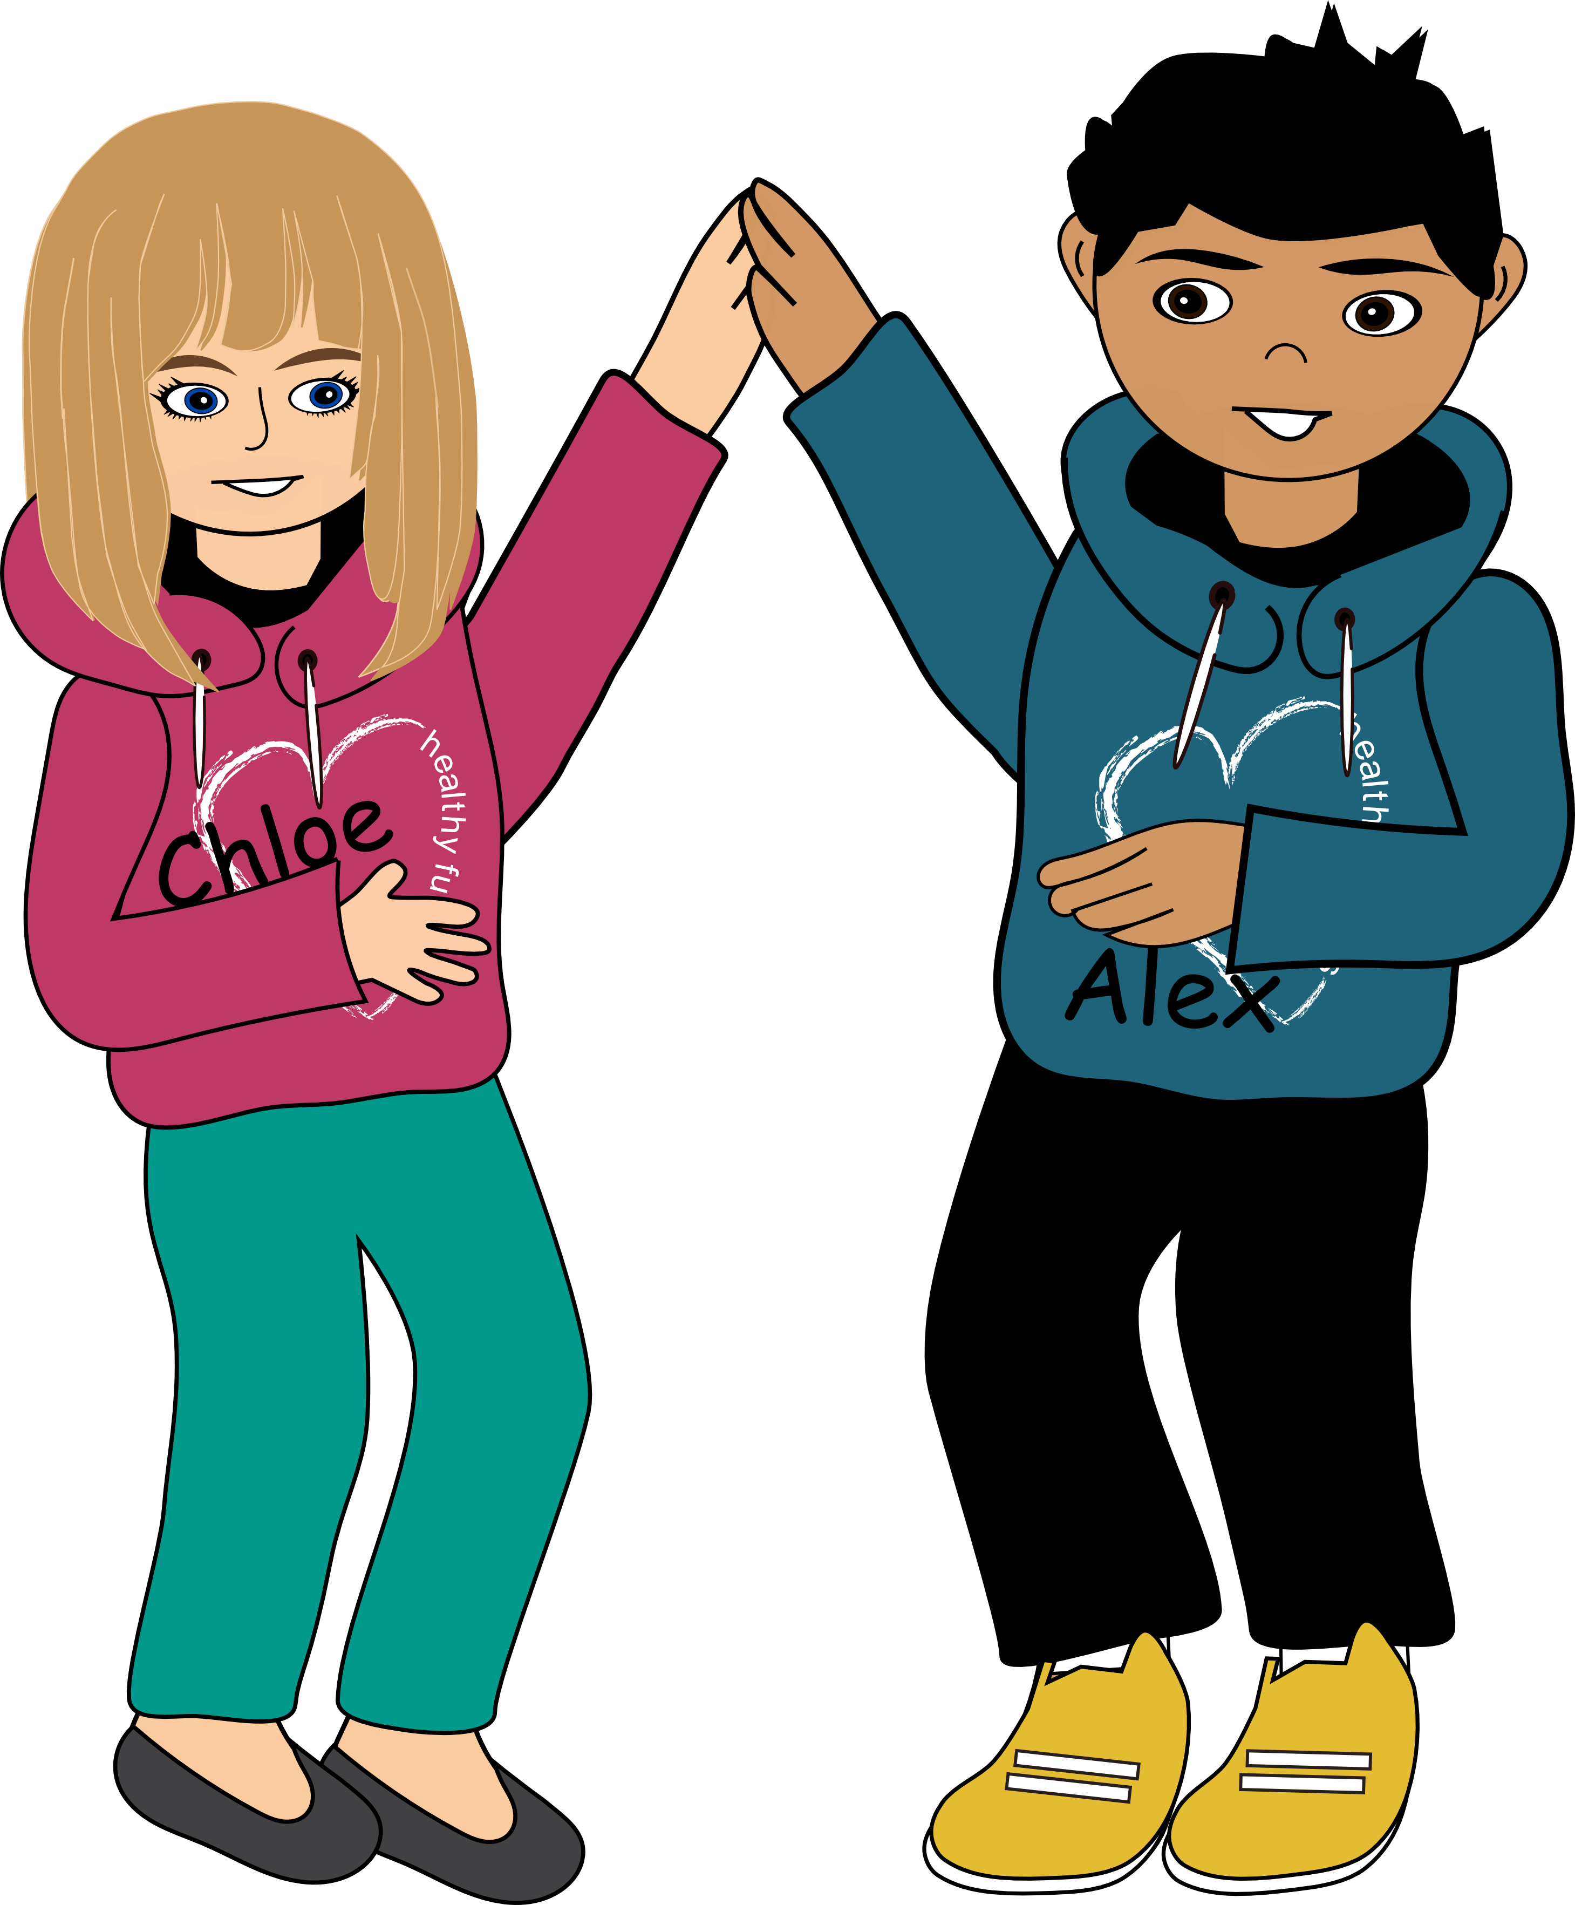
If Nothing Else Remember: The Golden Rule
Treat others as you would
want to be treated…
Listen to the other person in the same way you want them to listen to you.
Show respect to the other person, if you want them to respect you.
Stay focused on
the problem.
Session 6.7.2 Conflict Resolution
© 2013, 2023 Healthy Futures
Notes:
If you all remember nothing else (which I know won’t be the case) remember the Golden RULE: Treat others as you would want to be treated; by:
Listening to the other person in the same way you want them to listen to you.
Showing respect to the other person, in the same way you want them to respect you.
Lastly, staying focused on the problem, not the person.
So repeat it with me: Listen, Show respect and Stay focused.
Because the choices you make…NOW, will affect you… LATER!

